Slide 1
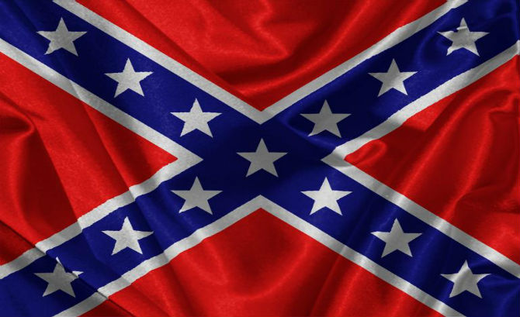
What does this symbolize?
Southern heritage. Pride. Dixie. Valor. Rebellion. Redneck. Slavery. Racism. Oppression. Fear.
Notes:
Symbols may stir different feelings in different people, but the one symbol that should define our feelings about all other symbols is the cross of Christ. Although it was a shameful form of execution, Jesus uses it as a symbol of complete devotion to Him. Those who understand the meaning of the cross are willing to suffer for it, are reconciled to God by it, and are willing to give up the entire world to maintain their connection with it.

Slide 2
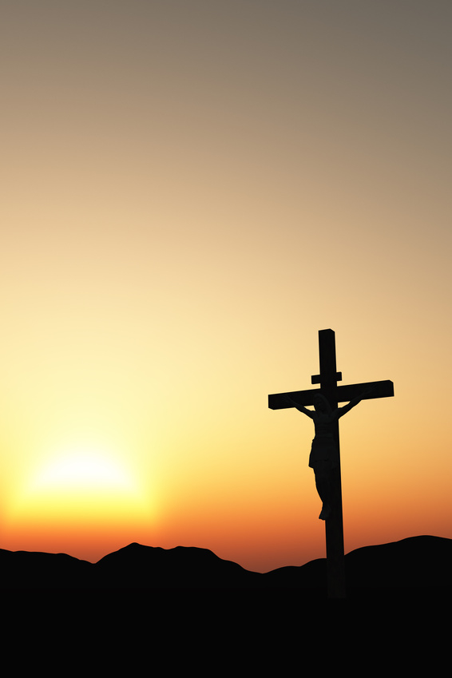
What does this Symbolize?
It means different things to different people (1 Cor. 1:18)
It was literally a shameful form of execution (Heb. 12:2; Galatians 3:13)
Jesus used the cross to symbolize a disciple’s complete devotion (Matthew 16:24-26; Mark 10:21; Galatians 2:20)

Slide 3
What does this Symbolize?
Identifying with the cross indicated a willingness to suffer persecution (Galatians 5:11)
It represents reconciliation to God (Ephesians 2:16; Colossians 1:19-20)
It is the Christian’s supreme symbol! (Galatians 6:14; Philippians 3:20)

Slide 4
What this means to us…
is determined by what this means to us.
2 Timothy 2:4 Philippians 3:20 1 Corinthians 9:22-23 Romans 14:13

Slide 5
The Cross is Everything to the Christian
“But God forbid that I should boast except in the cross of our Lord Jesus Christ, by whom the world has been crucified to me, and I to the world.”
(Galatians 6:14)

