Slide 1
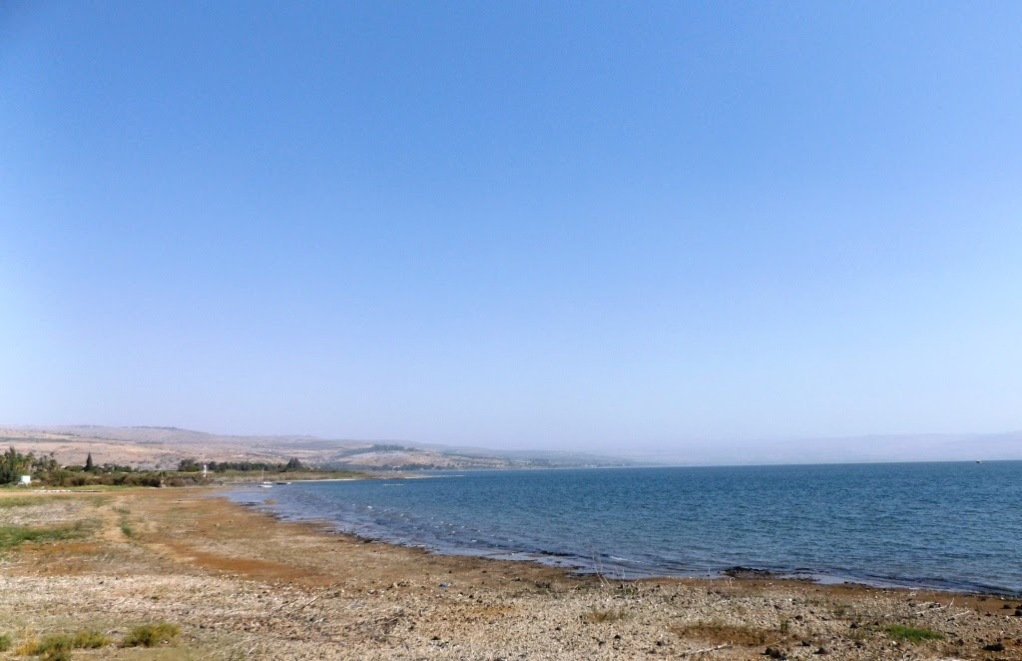
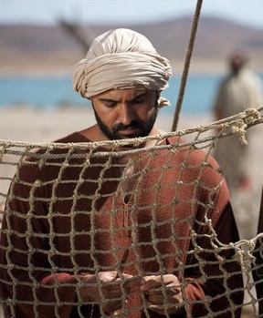
Simon’s Song
John 1:40-41  Luke 5:1-11
Notes:
Simon Peter underwent quite a transformation from a lowly, impetuous fisherman to become one of the most effective servants of God to ever live. Photo courtesy of www,LumoProject.com

Slide 2

Simon’s Shortcomings
Peter’s weaknesses seem numberless.
  Fear of sinking (Matthew 14:28-31).
  Fear of an unfaceable future (Matthew 16:21-23).
  Overconfidence (Matthew 26:33)
  Fear of foes (Matthew 26:73-75)

Slide 3
Peter’s Power
Peter was Perfected in Weakness
  Power to Preach in the face of persecution (Acts 4:1-13; 5:12-42).
  Power to Preach in the face of prejudice (Acts 8:25; 10—11).
  Perseverance in Prison (Acts 12:1-4).

Slide 4
What changed Peter?
Was it…
  His long association with the Lord? (Acts 4:13)
  The Lord’s reassurance? (John 21:18-19)
  His maturing faith?
  The baptism of the Holy Spirit? (Acts 1:8; 4:8)

Slide 5

What changed Peter?
The Power of a God who is TOO BIG TO FAIL!
“But those who wait on the LORD Shall renew their strength; They shall mount up with wings like eagles, They shall run and not be weary, They shall walk and not faint.” - Isaiah 40:31

