Slide 1
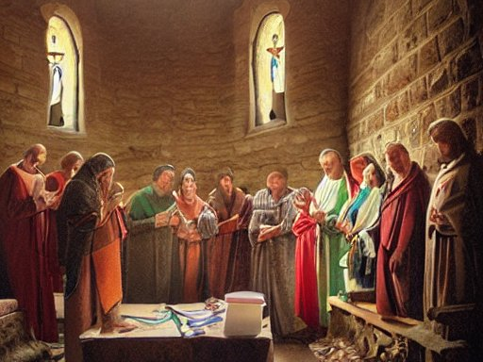
Constant Prayer by the Church
Acts 12:5 * Romans 12:10 * 1 Peter 3:12
Notes:
The Lord is ever aware of the challenges and trials of His people; through their constant connection to Him in prayer, He grants strength, comfort, and deliverance. Peter’s deliverance from Herod in Acts 12 illustrates that “the eyes of the Lord are on the righteous, and his ears are open to their prayer.”

Slide 2
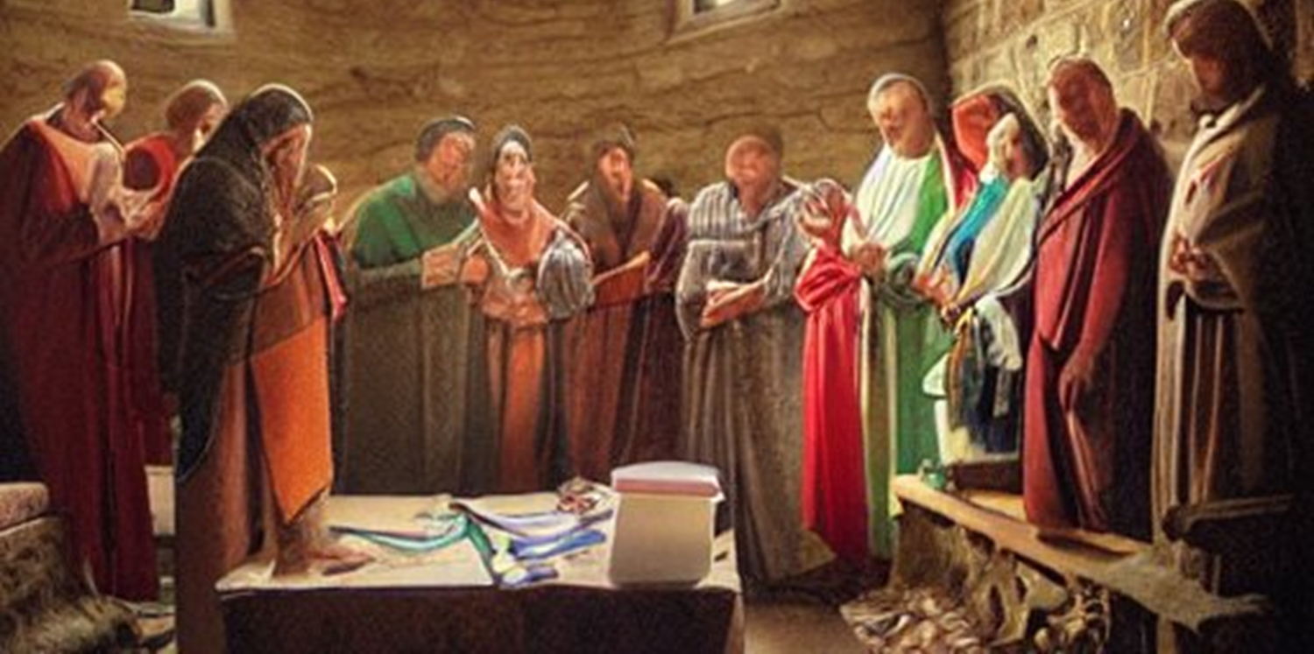
God sees our trials (Acts 12:1-4)
“For the eyes of the LORD are on the righteous…” 1 Peter 3:12
In Acts 12, God saw what the righteous were suffering at the hand of Herod.

Slide 3
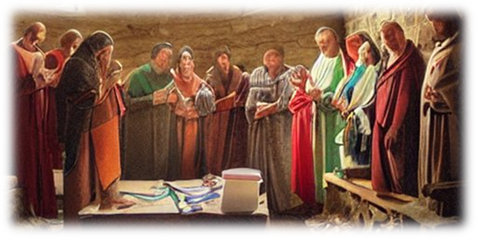
God Answers the Prayers of the Church (Acts 12:5-17)
“… and His ears are open to their prayers…” 1 Peter 3:12
The church prayed constantly (Acts 12:5).
The church exhibited faith and patience.
The activity of prayer extended beyond the regular assembly of the church (Acts 2:42; 3:1; 4:31; 20:36; 21:4-5).
  The church was a “House of Prayer” EVERYWHERE!

Slide 4
God Answers the Prayers of the Church (Acts 12:5-17)
“… and His ears are open to their prayers…” 1 Peter 3:12
God delivered Peter and James in different ways (cf. Philippians 1:21-23; Daniel 3:15-18).
God waited till the last minute, while prayer continued, faith grew, and peace guarded hearts (Acts 12:6; Philippians 4:6-7).

Slide 5
God deals with our enemies (Acts 12:18-24)
“But the face of the LORD is against those who do evil” (1 Peter 3:12).
Not long after these events, God struck down a prideful Herod.
“But the word of God grew and multiplied” (Acts 12:24).

Slide 6
Prayer requires a connection to God
Note that “the church” was praying.
  The church is the saved. Those who repented and were baptized in Acts 2:38-41 were saved and added to the church (Acts 2:47).
  Jesus is the Savior of the body, the church (Ephesians 5:23; 1:22-23).
  Let us make constant use of our connection to the Lord in the body of Christ!

