Slide 1


Slide 2
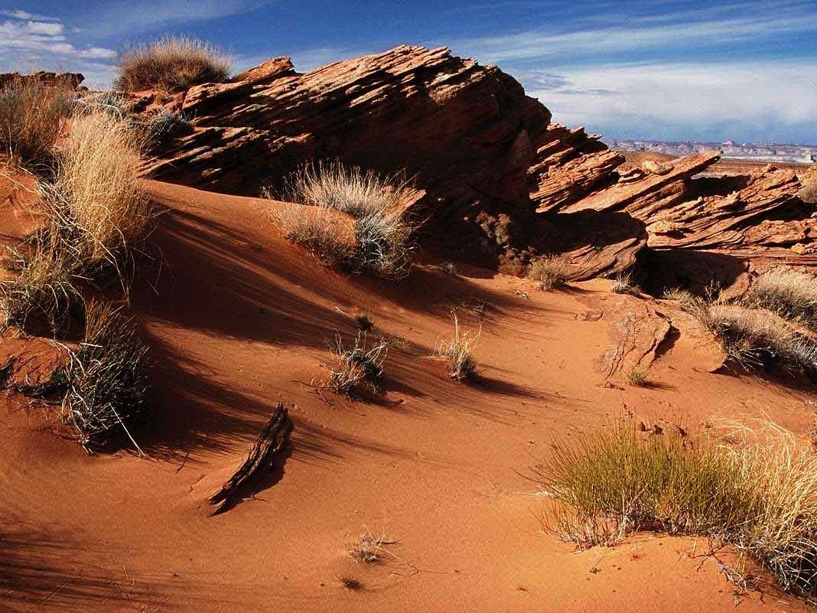
Jesus In The Wilderness - Luke 4:1-12
Turn the stone into bread.
The kingdoms of the earth.
Throw himself from the pinnacle of the temple.

Slide 3
Jesus In The Wilderness - Luke 4:1-12
Turn the stone into bread.
The kingdoms of the earth.
Throw himself from the pinnacle of the temple.

Slide 4
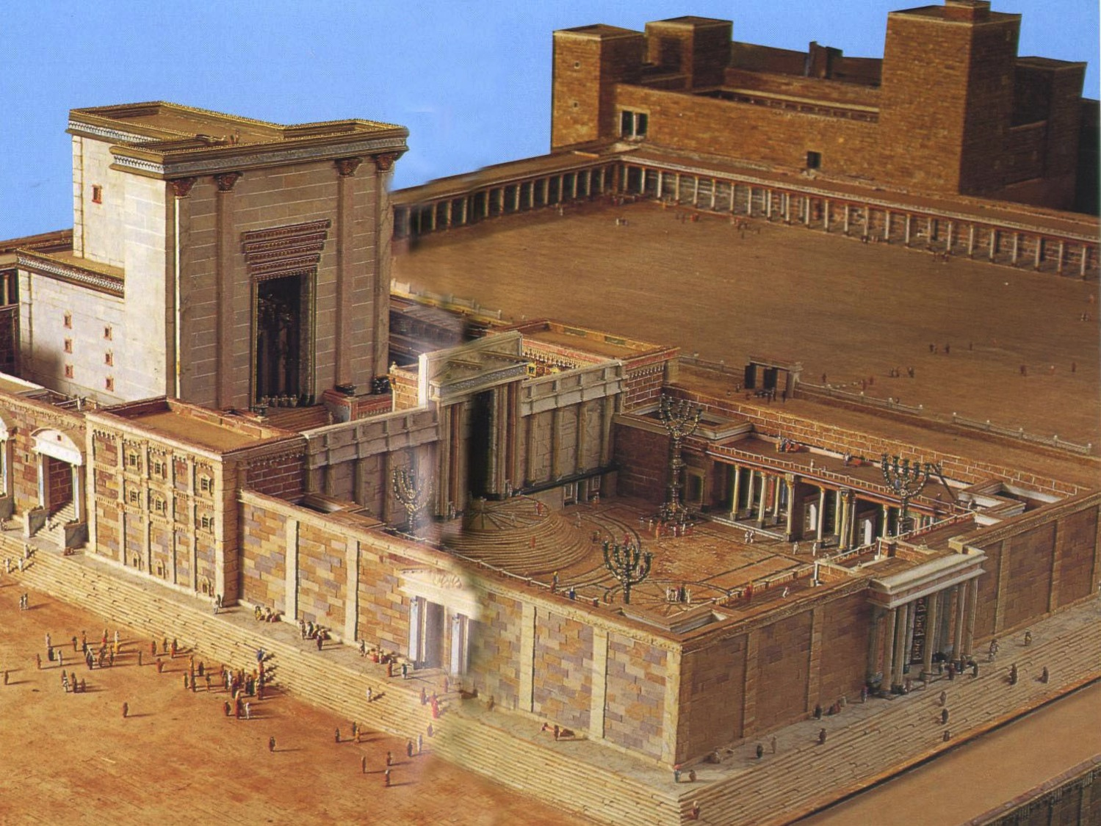

Slide 5
1
Luke 4:9-12
And Jesus answered him
“It is said, ‘You shall not put the Lord your God to the test.’ ”

Slide 6
1
2
Luke 4:9-12
Deut 6:16
“You shall not put the Lord your God to the test, as you tested him at Massah.”

Slide 7
1
2
3
Luke 4:9-12
Deut 6:16
Exod 17:1-7
“…because they tested the Lord by saying…
‘Is the Lord among us or not? ’ ”

Slide 8
Is The Lord Among Us Or Not?

Slide 9
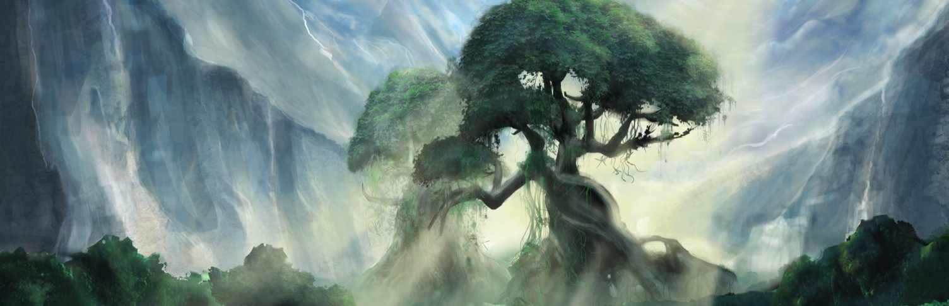
The Garden Of Eden
“And they heard the sound of the Lord God walking in the garden in the cool of the day…”
Genesis 3:8

Slide 10
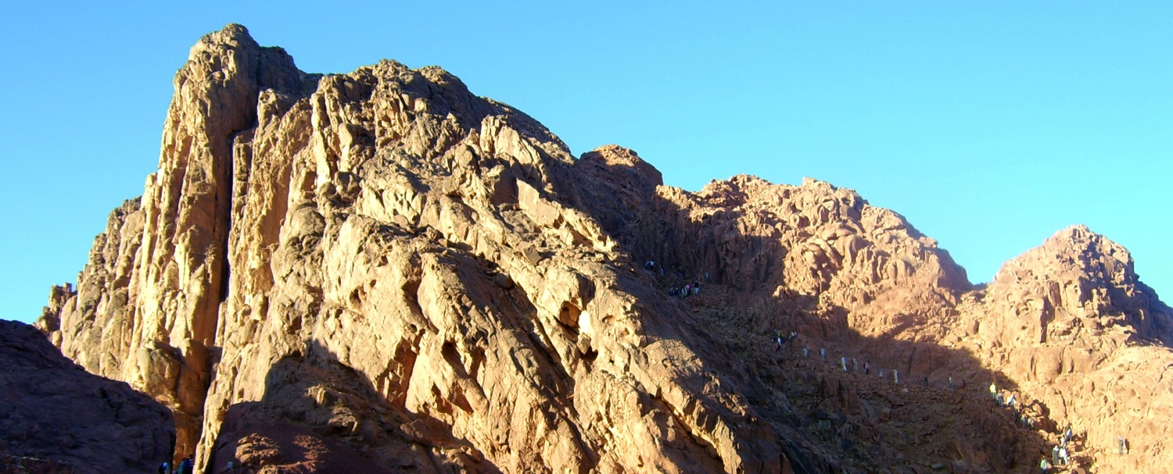
At Mount Sinai
“Then Moses brought the people out of the camp to meet God…”
Exodus 19:17

Slide 11
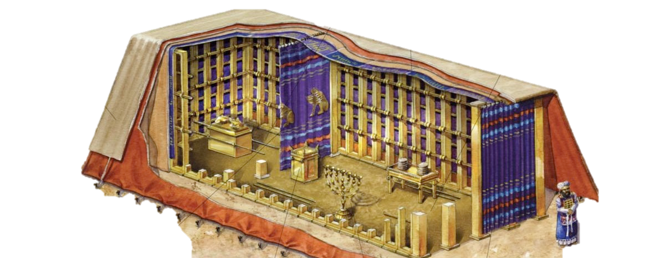
The Tabernacle
“And let them make me a sanctuary, that I may
dwell in their midst.”
Exodus 25:8

Slide 12
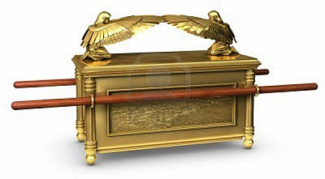
The Ark Of The Covenant
“There I will meet with you, and from above the mercy seat, from between the two cherubim that are on the ark of the testimony…”
Exodus 25:22

Slide 13
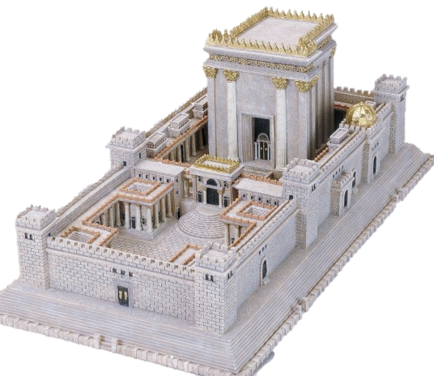
The Temple
“The Lord our God be with us,
as he was with our fathers. May he not leave us or forsake us…”
1 Kings 8:57

Slide 14
Promise Of A New Covenant
“And I will be their God, and they shall be my people.”
Jeremiah 31:33

Slide 15
John 1:14-18

Slide 16
?

Slide 17
1
2
3
Luke 4:9-12
Deut 6:16
Exod 17:1-7
“…because they tested the Lord by saying…
‘Is the Lord among us or not? ’ ”

