Slide 1
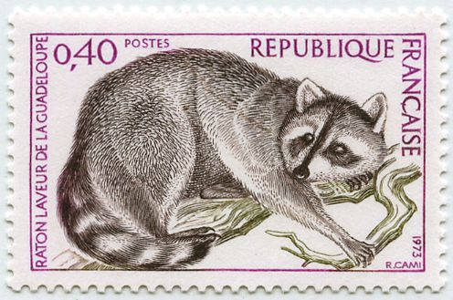
The Guadalupe Raccoon
A Special Species or a Trick of Tradition?
Notes:
Instrumental music in worship is a human tradition. It was introduced on the basis of bad information and faulty logic, and it continues to be practiced and defended in large part simply because it has become an accepted tradition.

Slide 2
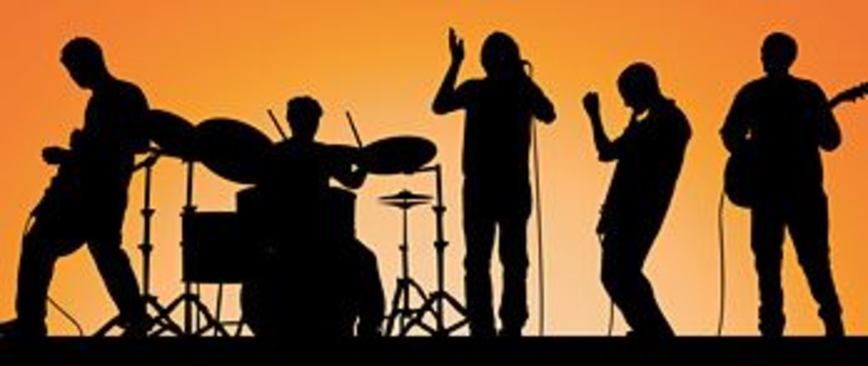
Instrumental Music
Acceptable Worship or a Trick of Tradition?

Slide 3

Instrumental music in worship was not widely accepted for centuries:
Clement of Alexandria (circa 150-216 AD) “Leave the pipe to the shepherd, the flute to the men who are in fear of gods and intent on their idol worshipping. Such musical instruments must be excluded from our wineless feasts…”
Eusebius of Caesarea (275-339 AD) “We render our hymn with a living psalterion and a living cithara with spiritual songs. The unison of voices of Christians would be more acceptable to God than any musical instrument. Accordingly in all the churches of God, united in soul and attitude, with one mind and in agreement of faith and piety we send up a unison melody in the words of the Psalms.”

Slide 4
Instrumental music in worship was not widely accepted for centuries:
John Chrysostom (347-407 AD) “David formerly sang songs, also today we sing hymns. He had a lyre with lifeless strings, the church has a lyre with living strings. Our tongues are the strings of the lyre with a different tone indeed but much more in accordance with piety.”
Augustine (354-430 AD) “…musical instruments were not used. The pipe, tabret, and harp here associate so intimately with the sensual heathen cults, as well as with the wild revelries and shameless performances of the degenerate theater and circus, it is easy to understand the prejudices against their use in the worship.”

Slide 5
Instrumental music in worship was not widely accepted for centuries:
Thomas Aquinas (Catholic Scholar, 1225-1274 AD) "Our church does not use musical instruments, as harps and psalteries, to praise God withal, that she may not seem to Judaize."

Slide 6
Early Protestant Denominations DID NOT Approve of Instruments
Martin Luther (1483-1546 AD) “The organ in the worship is an ensign of Baal.”
John Calvin (1509-1564 AD) “Musical instruments in celebrating the praises of God would be no more suitable than the burning of incense, the lighting of lamps and the restoration of other shadows of the Law. …the simplicity which God commands to us by the apostles is far more pleasing to Him.”
John Wesley (1703-1791 AD) “I have no objection to the organs in our chapels, as long as they are neither seen nor heard.”

Slide 7
Early Protestant Denominations DID NOT Approve of Instruments
Charles Spurgeon (1834-1892 AD) “The great congregation which is blessed with the privilege of listening to His instruction has no organ ‘to assist’ them in singing their praises to their God and Savior. They find their vocal organs sufficient. Their tongues and voices express the gratitude of their hearts… I would just as soon pray to God with machinery as to sing to God with machinery.”

Slide 8
Early Protestant Denominations DID NOT Approve of Instruments
Adam Clarke (1762-1832) “I am an old man, and an old minister; and I here declare that I never knew them productive of any good in the worship of God; and have had reason to believe that they were productive of much evil. Music, as a science, I esteem and admire: but instruments of music in the house of God, I abominate and abhor. This is the abuse of music; and here I register my protest against all such corruptions in the worship of the Author of Christianity.”
Presbyterian Board of Publications, Philadelphia, PA (1842) “Question 6. Is there any authority for instrumental music in the worship of God under the present dispensation? Answer. Not the least, only the singing of psalms and hymns and spiritual songs was appointed by the apostles; not a syllable is said in the New Testament in favor of instrumental music nor was it ever introduced into the Church until after the eighth century…”

Slide 9
How the Introduction of Instrumental Music was and is Rationalized
David did it!
But worship practices under the Old Law are not authority for worship practices today! (2 Chronicles 29:25-28; Acts 15:10; Galatians 3:10; James 2:11-12)
Uninformed appeals to the meanings of “Psallo” and “Psalmos”
“Psalm” does not refer exclusively to Old Testament psalms sung with the instrument (1 Corinthians 14:26)
The PRIMARY meaning of Psallo in Koine Greek is to SING!!!
The PRIMARY meaning of Psalmos is “a song, chant”

Slide 10
The New Testament COULD NOT BE CLEARER!
Ephesians 5:19 “Speaking to one another in psalms and hymns and spiritual songs, singing and making melody in your heart to the Lord.”
Colossians 3:16 “Let the word of Christ dwell in you richly in all wisdom, teaching and admonishing one another in psalms and hymns and spiritual songs, singing with grace in your hearts to the Lord.”
Acts 16:25 “But at midnight Paul and Silas were praying and singing hymns to God, and the prisoners were listening to them.”
1 Corinthians 14:15 “What is the conclusion then? I will pray with the spirit, and I will also pray with the understanding. I will sing with the spirit, and I will also sing with the understanding.”

