Slide 1
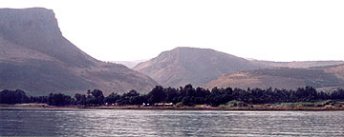
Mary and the Lamb
The Love and Devotion of Mary Magdalene
Notes:
We can learn a lot from Mary Magdalene’s love and devotion for Jesus.

Slide 2
The Root of Mary’s Devotion
She had been healed by Christ (Luke 8:1-3)
She may have been “empty” (Matthew 12:43-45)
She had been pitifully possessed by demons (cf. Luke 6:17-18; 9:38-39; Mark 5:2-5)

Slide 3
The Proof of Mary’s Devotion
She followed Christ (Luke 8:1-2)
She supported Christ (Luke 8:3; Galatians 6:6)
She witnessed the crucifixion (Mark 14:50; John 19:25)

Slide 4
The Proof of Mary’s Devotion
She witnessed Jesus’ burial (Luke 23:50-56)
She witnessed the resurrection (Matthew 28:1; Mark 16:9; Luke 24:1-8; John 20:1-16)
She proclaimed the resurrection (John 20:18; Mark 16:9-12)

Slide 5
Lessons from Mary Magdalene
God’s great love and mercy inspire great love and devotion.
God's faithful servants are often maligned, misrepresented and misunderstood.

