Slide 1
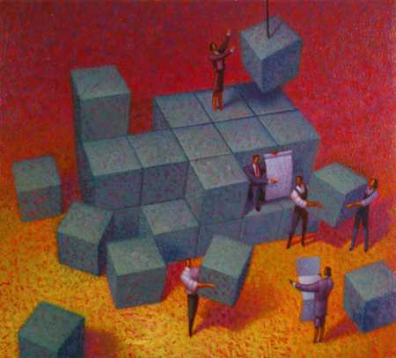
Building Together
Ephesians 4:16
Notes:
As we go through the process of appointing deacons, we are all working together to build the church. We must follow God’s design and carefully craft our attitudes and behaviors in order to excel at building up the church to God’s glory.

Slide 2
When we work together to select and appoint deacons…
We are building according do God’s design. (Philippians 1:1)
We select and appoint deacons according to God’s qualifications, not man’s opinions. (1 Timothy 3:8-13)

Slide 3
Those being considered as deacons need to remember…
A deacon is a servant! (Matthew 20:25-28)
To examine his own conscience (1 Timothy 3:9; Acts 24:16; 2 Corinthians 1:12)
Deacons must faithfully discharge their duties (1 Peter 4:10-11; 1 Corinthians 4:12)
Other duties must not be neglected (1 Timothy 3:11-13)

Slide 4
Let the congregation remember…
Prospective deacons have a right to hear from you personally if you have a question or concern about them.
  Whispering & backbiting are sins! (2 Cor. 12:20)
  We must pursue peace and avoid bitterness! (Hebrews 12:14-15)
Matters of opinion and judgment must be ruled by humility, love, and deference (Philippians 2:1-4; Jude 20-21)

Slide 5
Let us all “strive to excel in building up the church”! (1 Corinthians 14:12)

