Slide 1
God’s Word Is Truth!
Evidence from the Book of Daniel
Blessed be the name of God forever and ever,
to whom belong wisdom and might.
He changes times and seasons;
he removes kings and sets up kings;
he gives wisdom to the wise
and knowledge to those who have understanding;
he reveals deep and hidden things;
he knows what is in the darkness,
and the light dwells with him. Daniel 2:20b-22

Slide 2
The time and setting of the book of Daniel
Third year of Jehoiakim, King of Judah, Nebuchadnezzar of Babylon besieged Jerusalem. God allowed Judah to fall to Babylon in 605 BC.
Nebuchadnezzar commanded that young talented people be brought Babylon and trained to serve him. Daniel, Hananiah, Mishael, and Azariah were among these. Daniel remained in Babylon for at least the next 6 to 7 decades.

Slide 3
The time and setting of the book of Daniel
Daniel is the prominent character of the book. There is nothing to suggest that he is anything but a real character.
Understanding when the book was written and when the events in it occurred allows us to see powerful prophecies contained in it.

Slide 4
The Book of Daniel
What makes it hard to understand?
God used visions and dreams to reveal the future. This included figurative language, and unnatural beings that represent forthcoming powers, leaders, and events.
Some involve warring parts of the ancient Grecian empire with which we may have little familiarity.
Understanding requires non-Biblical sources.
Some prophecies will occasionally skip ahead in time.
Some prophecies are repeated with different visions.

Slide 5
What can we learn from studying these Prophecies?
Stunningly accurate predictions that prove the Bible is of Divine inspiration.
Impacts to the Jewish people who lived during this time.
Events that shaped the political situation that existed when Christ came into the world.
No matter how bad things may get, God is still in control.
Some themes similar to those used in The Revelation.

Slide 6
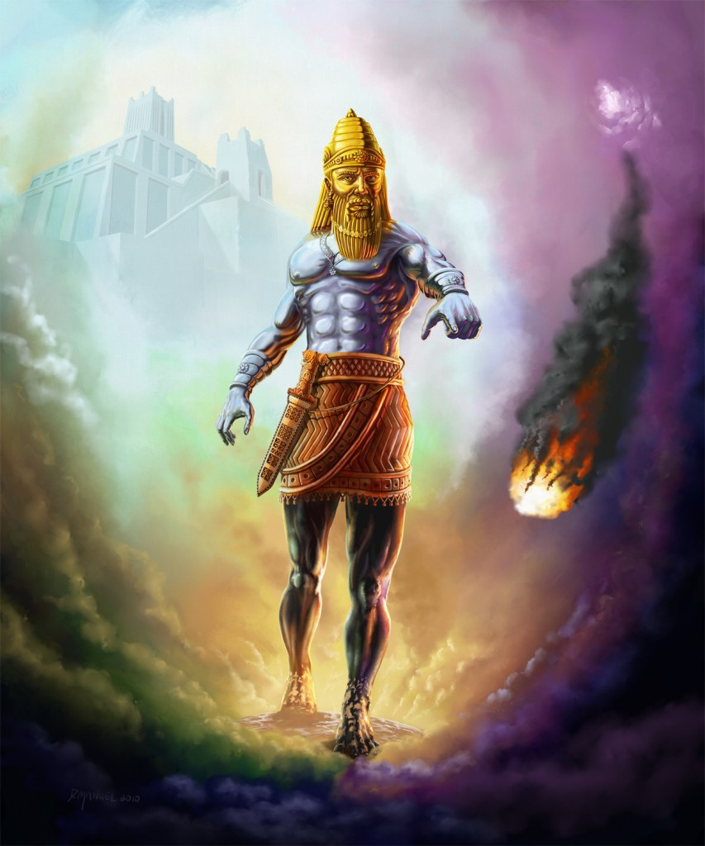
Daniel 2
Gold: Babylon (605-539 BC)
Silver: Medo-Persia (539-331 BC)
Bronze: Greece (331-168 BC)
Legs of Iron/Feet mixed
Rome (168 BC-476 AD)
Stone strikes the feet of the image and destroys it:
IN THE DAYS OF THESE KINGS (i.e. Romans), God’s eternal kingdom would be established
Head of
Gold
Chest of
Silver
Belly/Thighs
of Bronze
Stone strikes
Image
Legs of Iron
Feet of Iron
& Clay

Slide 7
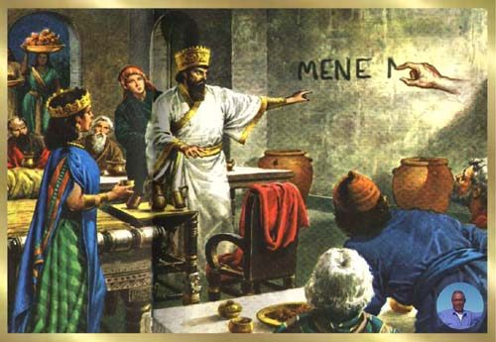
Daniel 5 – Handwriting on the Wall
Belshazzar is holding a feast, when handwriting appears on the wall.
Daniel is brought in to interpret.
God reveals that Babylon would fall to Medo-Persia. This happened that same night in 539 BC.
A few sources mention that a feast was being held when Babylon fell.

Slide 8
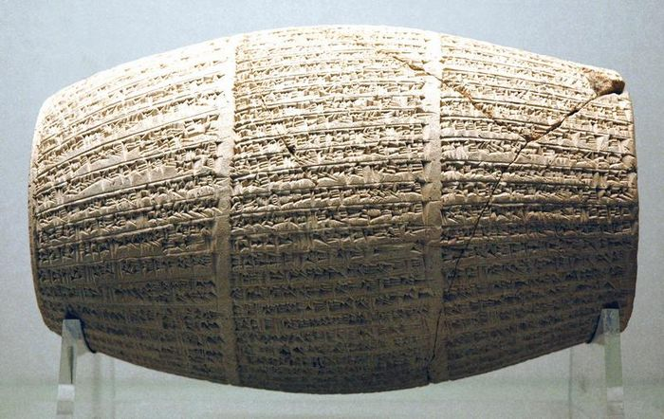
Daniel 5 – Handwriting on the Wall
For centuries, skeptics doubted the existence of Belshazzar, because no other known source mentioned him.
In 1854, cylinders were un-earthed in Iraq that contained cuneiform writing that mention Belshazzar.
They show that Belshazzar was a co-regent with his father. This explains why Daniel was offered 3rd position in the kingdom.

Slide 9
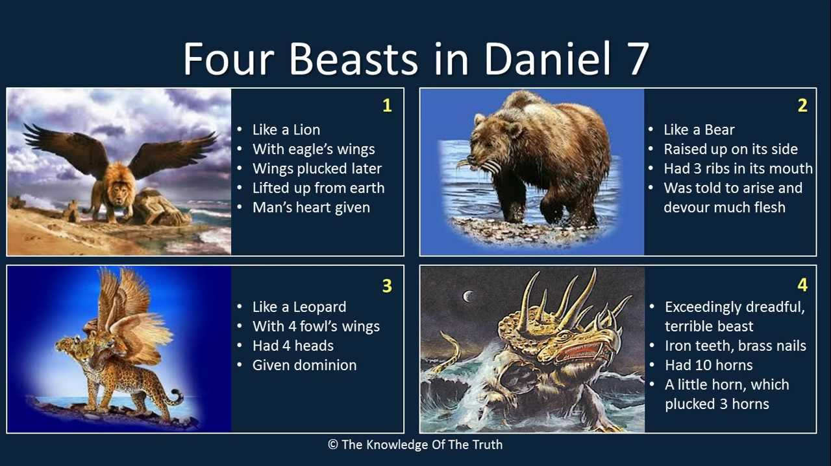
Babylon
Medo-Persia
Greece
Rome

Slide 10
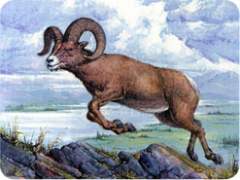
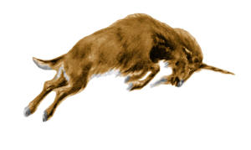
Daniel 8
The earlier visions in Daniel 2 and 7 deal with four kingdoms, beginning with Babylon. Daniel 8 deals with two of the four (Medo-Persia & Greece).
In Chapter 8, Daniel sees a vision of a Ram & a Goat (8:3-14).
              (8:20,21) These represent Medo-Persia & Greece.
Medo-Persia
Greece

Slide 11
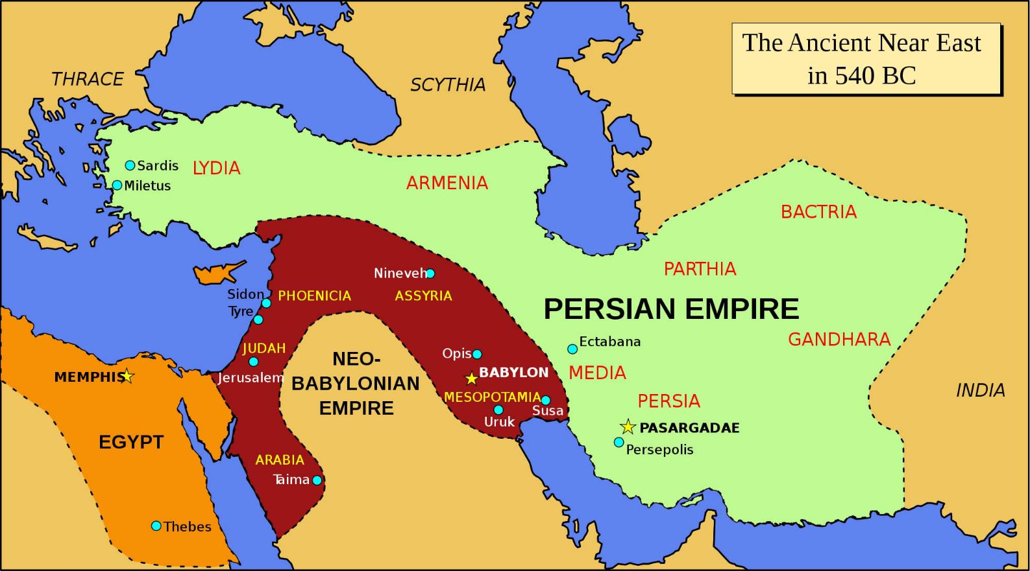
Daniel 8:4

Slide 12
Daniel 8
(8:5) Goat came from the west, not touching the ground
  Greece was to the west of Media/Persia; Indicative of the speed at which the Greeks conquered.
(8:5,21) Goat had a notable horn which represented Greece’s first king.
  Alexander the Great was the king represented by the horn. He launched an unprovoked attack against Persia in 334 B.C.

Slide 13
Daniel 8
(8:8,21) But when he became strong, the large horn was broken.
  In 323 BC, Alexander died at the height of his power at age 33.
(8:9,22) Four horns took the place of the large broken horn.
    The 4 horns represent the 4 four kingdoms that developed from Alexander’s Greek empire, each ruled by generals of Alexander:

Slide 14
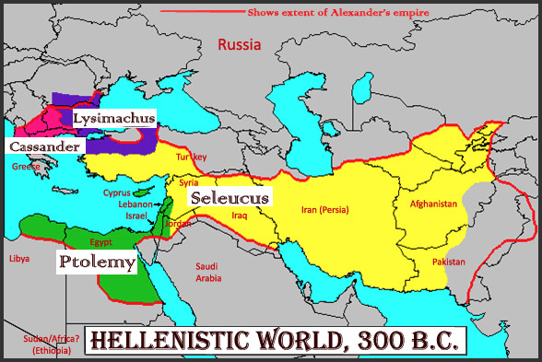
Daniel 8:22

Slide 15
Daniel 8
(8:9) One little horn came out of the Goat’s 4 horns
  Antiochus IV Epiphanes who gained control of the Seleucid region in 176 BC. He persecuted Palestine and Jerusalem.
(8:9) From the 4 horns came one that grew great toward the south, east, & the glorious land.
    Antiochus IV went against Egypt, Persia and Judah.

Slide 16
Daniel 8
  Vs. 9-10 Antiochus IV exalted himself “To the host of heaven, cast down some of the host, and of the stars and stamped upon them. Magnified himself to the prince of the host. Daily sacrifice was taken away. Sanctuary cast down.

Slide 17
Daniel 8
    Exalted Greek Gods above the true God
    Desecrated the temple. In 167 BC, he forbade Jews to observe OT laws of diet, circumcision, Sabbaths
    Persecuted Jews. Sought to impose Greek culture on Judah. Had Gymnasiums built.
    Put an image to Zeus in the temple & offered swine on the altar.

Slide 18
Daniel 11
Most detailed prophecies in the Bible. Advanced survey of events from the Persian period well into the Grecian period.
Unlike the preceding prophecies in Daniel, this vision does not the same figurative, symbolic language, characters, and beings.
Details regarding the motives, events, tactics, agreements, activities, and interests of rulers and their kingdoms are given.

Slide 19
Daniel 11
After Alexander died, and the four kingdoms developed, the Ptolemaic (of Egypt) and Seleucids (of Syria) fought for dominance.
King of the South used to represent Ptolemy’s.
King of the North used to represent Seluecids.
Despite the terrible things that happened to God’s people, they could still recognize that God’s was in control.
We will sample only a few of the prophecies.

Slide 20
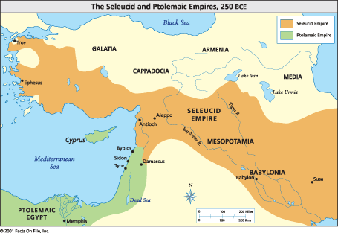
Seleucid and Ptolemaic Empires

Slide 21
Daniel 11:2
“Three more kings will arise in Persia”
  Cambyses II (529-523 B.C.)
  Gaumata (also referred to as Pseudo-Smerdis 523-522 B.C.)
  Darius III (522-485 B.C.).
“and a fourth shall be far richer than all of them”:
    Fulfilled by Xerxes I, whose incredible wealth was renowned (substantiated by ancient several writers including Herodotus)

Slide 22
Daniel 11:3
“and a mighty king shall arise”:
  Fulfilled by Alexander the Great. He utilized an experienced military to break the power of Persia and built one of the largest and most diverse empires in history.
“shall rule with great dominion and do according to his will”:
  Alexander’s forces conquered amazing speed.
  Attributed to his intellect and skills.

Slide 23
Daniel 11:4
  “And as soon as he has arisen”
    At the height of his power.
  “His kingdom shall be broken and shall be divided”
    Alexander died at age 33, at the height of his military power.
    After his death, a series of civil wars erupted that resulted in division.

Slide 24
Daniel 11:4
“Toward the four winds of heaven, but not to his posterity, nor according to the authority with which he ruled, for his kingdom shall be plucked up and go to others besides these”
    A fourfold division emerged, with
    Ptolemy over Egypt
    Seleucas over Syria, Asia Minor, and the East.
    Lysimachus over Thrace
    Cassander over Macedonia and Greece.
    Neither of his two sons succeeded him.

Slide 25
Remainder of Chapter 11
Ptolemy’s and Selucids (vs. 5-20)
Reign of Antiochus IV Epiphanes
Maccabean Revolt
Note that each of the specific things mentioned were fulfilled by specific events and people.

Slide 26
What do Skeptics Say About Daniel?
Skeptics cannot deny the remarkable accuracy of the predictions in the book of Daniel, but they do not accept the possibility of prophecy ever existing.
Some modern scholars assign a 2nd century date to Daniel, claiming that the author simply wrote history. However this claim defies overwhelming evidence and logic.
The book of Ezekiel (written in the 6th century BC) contains references to Daniel. The context makes it obvious that it is the Daniel of the OT.

Slide 27
What do Skeptics Say About Daniel?
    Copies of the book of Daniel were found in the Dead Sea Scrolls among other OT books. This means that Essenes considered the Book of Daniel to be scripture.
    The Dead Sea Scroll copies date to the late 2nd Century BC, (within the same general time frame as the Maccabean revolt).
    A 2nd century date for the book does not leave enough time for it to have reached canonical status by the late 2nd century.

Slide 28
Critics’ Views of the Book of Daniel
  For the 2nd century date to be true, this requires that someone to have written a forgery in which he inserted a fictional character who supposedly served and interacted with political figures 4 centuries prior. And the writer had a great knowledge of Babylonian and Medo-Persian empires.
  And it means that 2nd century Jews would have accepted the forgery as scripture practically as soon as (or not long after) it was written.

Slide 29
Critics’ Views of the Book of Daniel
  Language used in the book of Daniel is more indicative of that from the 6th century. Certain Persian words were used in the 6th century but had fell out of usage by the 2nd Century.
  The Jewish historian Josephus records that when Alexander the Great entered Jerusalem, he was shown the prophecy in Daniel concerning the Greeks, and he realized that it was about him.

Slide 30
Answers to the Critics’ Arguments
The language of Daniel begins with Hebrew, changes to Aramaic from chapter 2:4 through 7:28, returns to Hebrew in 8:1 for the remainder of the book.
The latter section of Hebrew is not as elegant as that of other books of the OT
Critics use this to claim the book was not written in the 6th century.

Slide 31
Answers to the Critics’ Arguments
  Daniel had spent most of his life in Babylon where Aramaic was the common language used. It seems reasonable that he would have used the Aramaic for at least some of the book.
  After decades in Babylon, his fluency in Hebrew would have no doubt diminished.
  Therefore, the criticism actually becomes an argument in favor of the book’s historicity.

Slide 32
  Some are gambling their eternal destiny on the belief/hope that the Bible isn’t true.
  That what it says about sin isn’t true.
  That its promise of eternal life isn’t real.
  In what do you place your hope?

