Slide 1
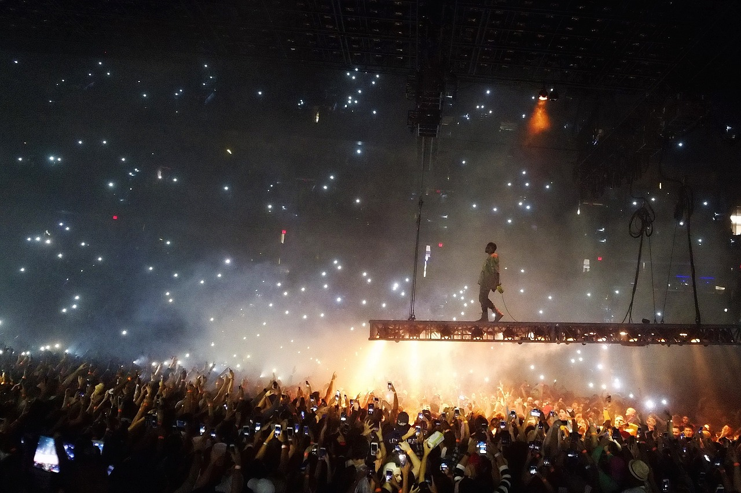
“To Be Seen by Men”
The Motive of the Hypocrite
Matthew 6:1-18
Notes:
The motivations for our actions can by the difference between hypocrisy and true holiness. Are we trying to be seen by others, or are we trying to bring glory to God?

Slide 2

What’s Your Motivation?
In Matthew 6:1-18, Jesus deals with religious hypocrisy.
There is no conflict between this text and Matthew 5:14-16.
In Matthew 5, the motivation is the glorification of God; in Matthew 6, the motivation is the glorification of self.
Are you Giving for your own Glory? Praying for your own Praise? Fasting for your own Fame?

Slide 3
When Self-Glorification Pervades One’s Life
All of life becomes a popularity contest (Matthew 23:5-12).
Clothing is chosen to attract attention or make a statement (1 Peter 3:3-4).
Public pronouncements are intended to gain praise or make an impression (John 12:42-43; Romans 2:28-29; Gal. 1:10).

Slide 4
Who are you When Nobody is Watching but God?
When you are giving? (Matthew 6:3-4)
When you are praying? (Matthew 6:6-8)
When you are fasting? (Matthew 6:17-18)
Do you feel the need to let people know about the sacrifices you are making and how committed you are? (Luke 18:9-14)

Slide 5
Whose Glory do You Seek?
Pride is insidious. It seems like the path to glory, but it delivers humiliation (Luke 18:14; Proverbs 25:27).
Seek God’s glory
“Therefore, whether you eat or drink, or whatever you do, do all to the glory of God” (1 Corinthians 10:31).

Slide 6
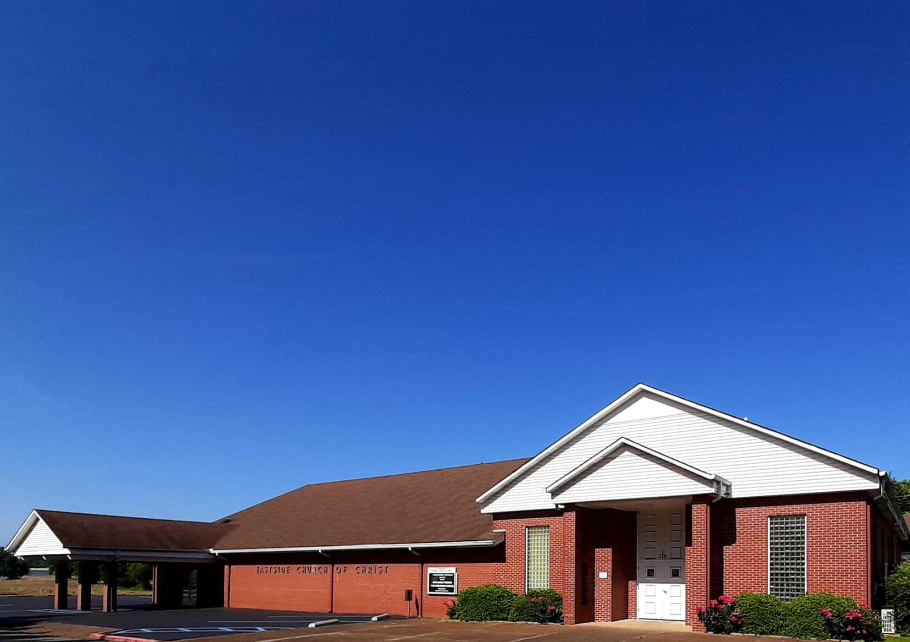
Eastside Church of Christ
Eastside-church.org

