Slide 1
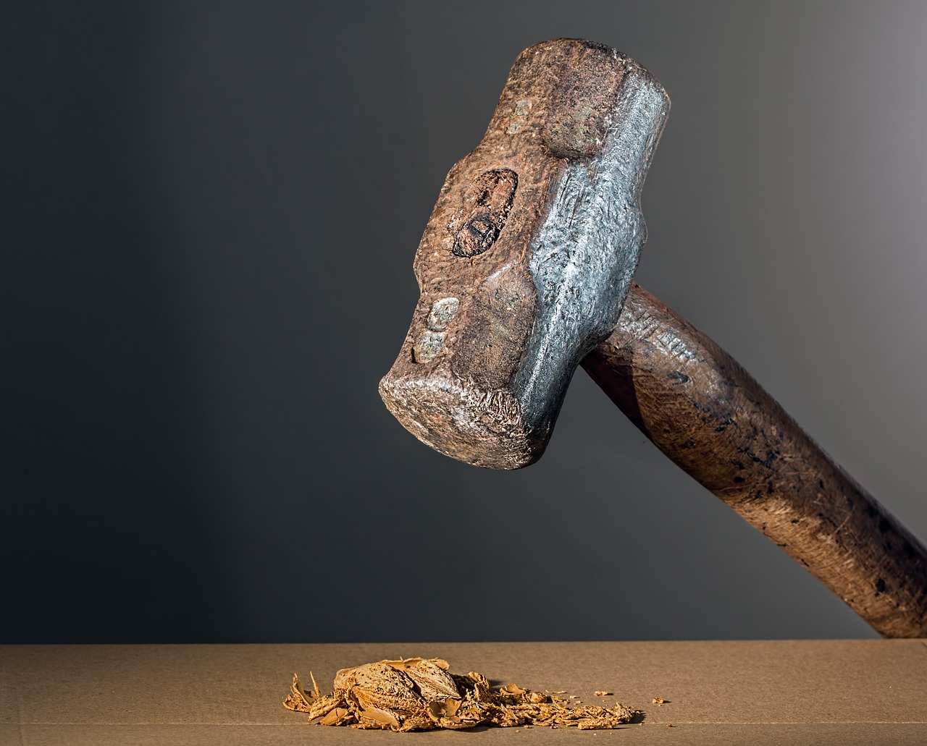
Moral Absolutes in a World of Moral Ambiguity
"Is not My word like a fire…and like a hammer that breaks the rock in pieces?” (Jeremiah 23:29)
Notes:
In a world in which truth is flexible and morals ambiguous, God’s people endure to hold to the moral absolutes found in HIs word.

Slide 2
The Bible uses various terms to discuss "morality"
“Morals” are “principles of conduct” (Webster).
“Morality” is “being in accord with principles or standards of conduct” (Webster).
Words like “conduct,” “conversation,” “behavior” or “manner of life” point to moral living (Ephesians 2:3; 1 Peter 1:15-18; 2:12; 3:1-2, 16).

Slide 3
God has given us Moral Standards
Moral behavior is what our heavenly Father requires (1 Peter 1:17).
Moral behavior is what we desire (Hebrews 13:18).
The devil and his minions want to lure us back into immoral behavior (2 Peter 2:18).
God’s work of grace and love elevates our morals!
He has raised us out of the immorality of the world (Ephesians 2:1-6).
He has called us to holiness (1 Peter 1:14-15).
We can live moral lives by the grace of God (2 Corinthians 1:12).
We must not allow the immorality of the world to corrupt us (1 Corinthians 15:33).

Slide 4
Immorality is Satan’s Well-used Trap
The church is ever in peril of sinking into the world that surrounds it.
Pergamos and Thyatira are examples (Revelation 2:20).
The church in Corinth was surrounded by a sea of immorality (1 Corinthians 6:9-10).

Slide 5
God’s word is an absolute standard of morality.
God’s law exposes the lawless (1 Timothy 1:9-11).
Yet God’s standard is rejected in our culture.
Like Corinth, and Pergamos and Thyatira, the church today is being deluged with the immorality of our culture.
Sexual immorality on the rise.
Cohabitation without marriage.
Unwed mothers.
Homosexuality is celebrated.
Alcohol use and abuse is at an all-time high.

Slide 6
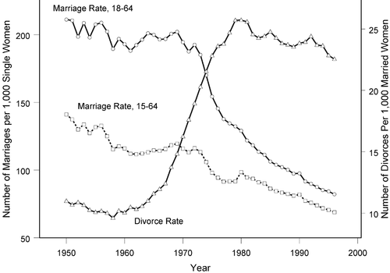

Slide 7
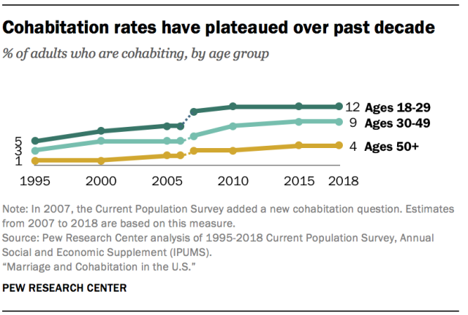

Slide 8
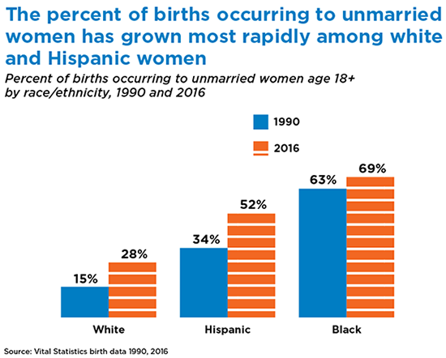

Slide 9
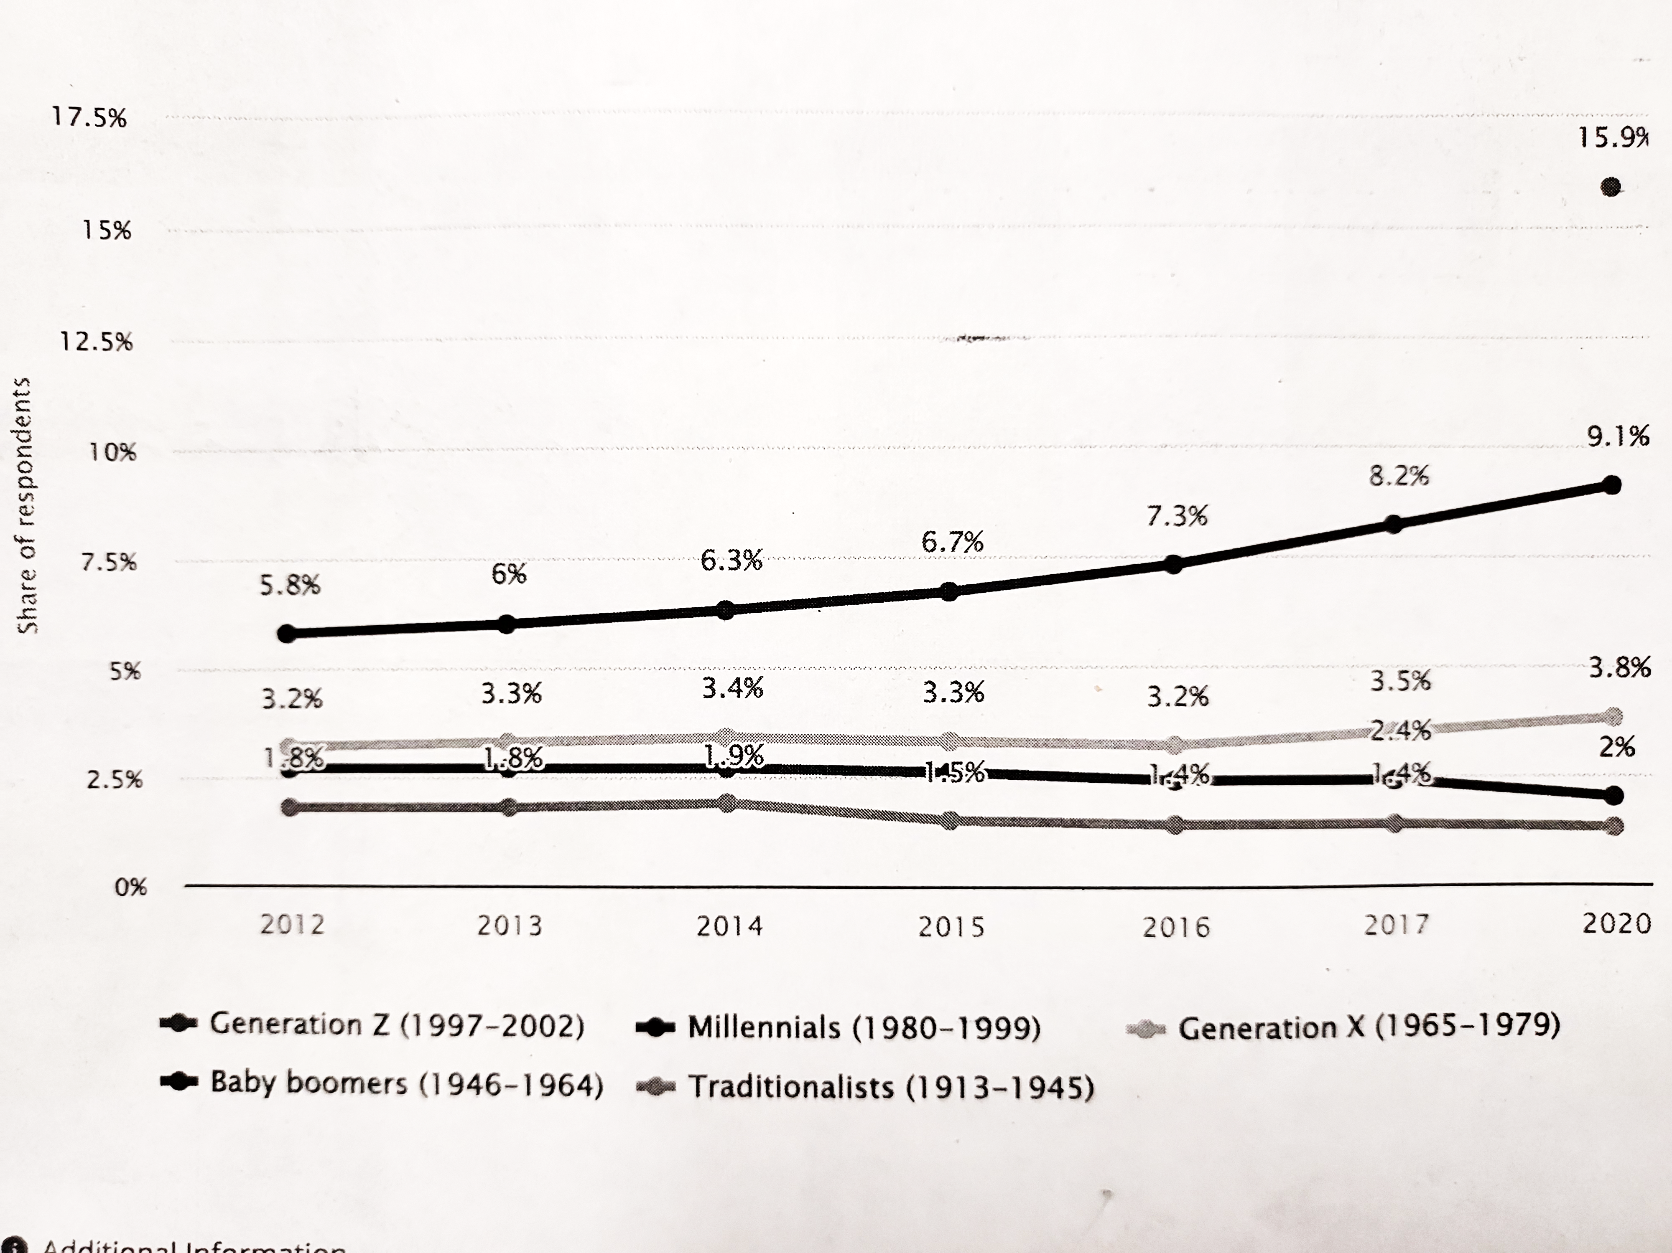
Americans who identify as LGBT 2012-2020 by Generation – Statista

Slide 10
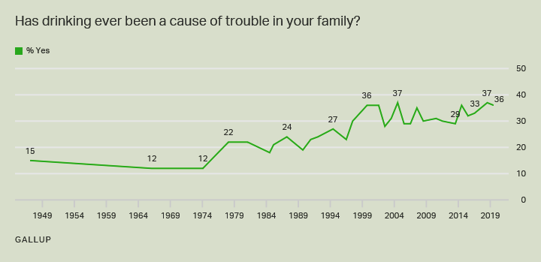

Slide 11
The Moral standards of God’s eternal word remain:
Sexual relations between a man and a woman belong in marriage and nowhere else (Hebrews 13:4; Ephesians 5:3; Matthew 19:4-6; 1 Corinthians 6:9-10).
We are to flee fornication (1 Corinthians 6:18-19).
Drinking must be left behind (1 Peter 4:3-4; Ephesians 5:18).

Slide 12
2 Corinthians 6:17-18
“Come out from among them and be separate,” says the Lord.
“Do not touch what is unclean and I will receive you. I will be a Father to you,
and you shall be My sons and daughters," says the Lord Almighty.

