Slide 1

“I will sing with the spirit, and I will also sing with the understanding.”
1 Corinthians 14:15

Slide 2
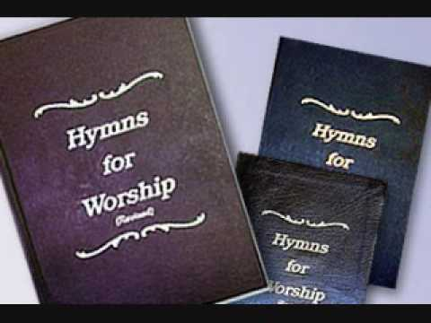
Songs are sung “for edification”
1 Corinthians 14:26 “How is it then, brethren? Whenever you come together, each of you has a psalm…Let all things be done for edification.”
Singing is for edification, for teaching and admonishing one another, and for praising God.
  Colossians 3:16, “Let the word of Christ dwell in you richly in all wisdom, teaching and admonishing one another in psalms and hymns and spiritual songs, singing with grace in your hearts to the Lord.”
  Ephesians 5:19, “Speaking to one another in psalms and hymns and spiritual songs, singing and making melody in your heart to the Lord.”

Slide 3
Singing in worship to God must come from the heart.
  Grace and melody are to be in the HEART as we sing!
“My heart is steadfast, O God, my heart is steadfast; I will sing and give praise.” (Psalms 57:7)
“I will praise You with my whole heart; Before the gods I will sing praises to You.” (Psalms 138:1)

Slide 4
Considerations for singing with the spirit and the understanding:
Do I understand the words of a song and their collective meaning?
Is a song accurate in reference to Bible history?
Is a song doctrinally correct?
Consider “Night with Ebon Pinion” (#162)

Slide 5
Allowing for the use and interpretation of figurative language:
  Note the use of such language in the inspired Psalms:
  Psalm 23:1-2, 5
  Is the Lord a literal Shepherd?
  Does He literally make me lie down in green pastures?.
  Has He literally prepared a table before me?
Psalm 1:1
  Can you walk on a sidewalk that sinners have walked on?
  Can you sit in a seat where a scornful person has sat?

Slide 6
Allowing for the use and interpretation of figurative language:
Psalm 2:8-9
  Will the Lord break the nations with a rod of iron?
Psalm 3:6-7
  Did God literally strike all David’s enemies on the cheek?
  Has He broken the teeth of the ungodly?

Slide 7
Correctly interpreting statements of fact:
  Even in inspired songs, there are statements of fact that must be taken in a certain way to be accurate.
Psalm 51:4-5, “Against You, You only, have I sinned, And done this evil in Your sight— That You may be found just when You speak, and blameless when You judge. Behold, I was brought forth in iniquity, and in sin my mother conceived me.”
  Had David not sinned against Uriah and Bathsheeba?
  Was David born sinful, or into a sinful world that engulfed him?

Slide 8
Applications to Songs in Our Song Books
  Can we sing…
  “Night With Ebon Pinion”?
  “Ten Thousand Angels”? (HFW #580)
  “My Eyes Have Seen Your Glory”? (HFW Supp. #10).
  “I Know Whom I Have Believed”? (HFW #350)
  “The Solid Rock”? (HFW #378)
  “Jesus is Coming Soon”? (HFW #386)

Slide 9
Principles for Singing with the Spirit & Understanding
Do not sing a song that violates your conscience.
  (Romans 14:22-23)
Consider how figurative and symbolic language are being used in a song.
Choose to attach a Scriptural meaning to questionable words and phrases if at all possible.
Song leaders:
  Select songs that will edify & make for peace. (Romans 14:19)
  Take time to define words that may be hard to understand.
  Briefly describe the symbolism of a song, and explain how it can be taken in a Scriptural way.

