Slide 2

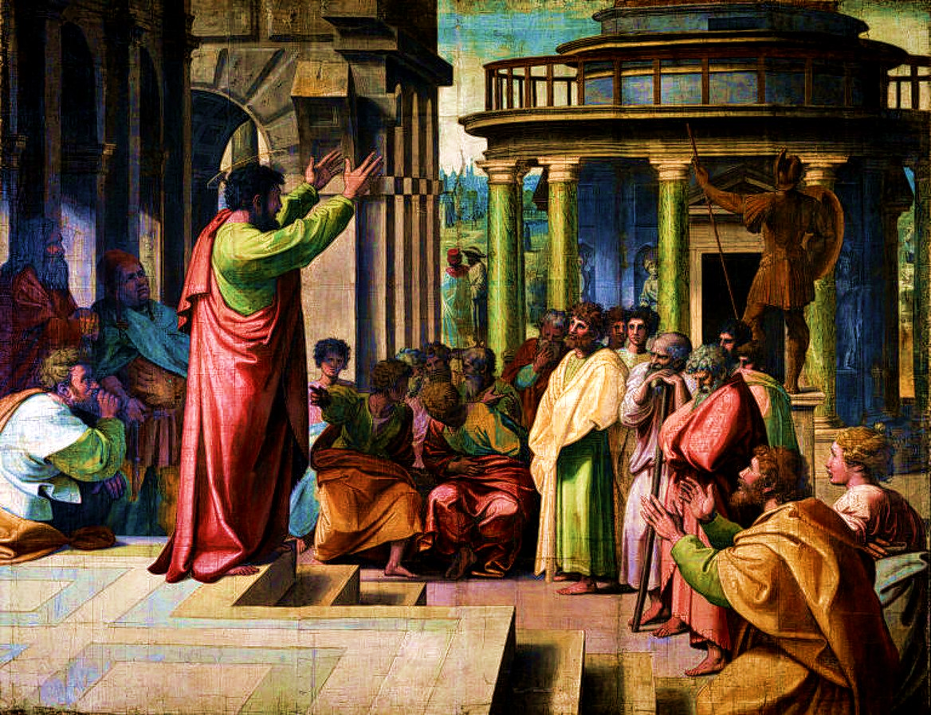
Colossians 4:2-4
Romans 15:30-32
1 Thessalonians 5:25
Notes:
Paul pleaded for prayers to make his preaching more effective. Continual, earnest prayer empowers evangelism. It emboldens the evangelist and clears paths for the gospel.

Slide 3
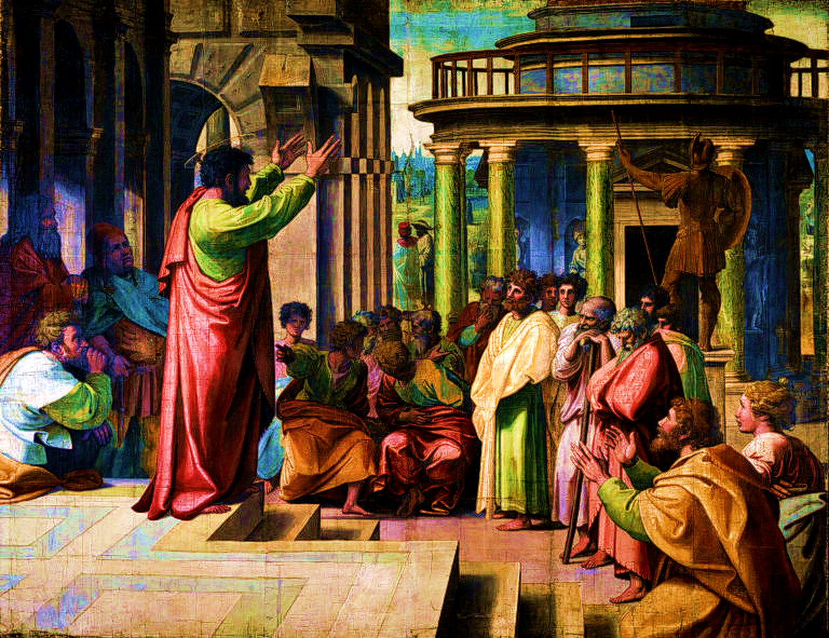
A Mandate to Pray
Colossians 4:2
“Continue earnestly” – “to be steadfastly attentive unto, to give unremitting care to a thing”
  Ephesians 6:18; 1 Thess. 5:17; Romans 12:12
“Being vigilant” – being alert to pray; looking at things with an eye to praying about them
  Ephesians 6:18; 1 Peter 4:7
“With thanksgiving”
  1 Thessalonians 5:18; Philippians 4:6; Ephesians 5:20

Slide 4
Praying for Open Doors Colossians 4:3-4
Our Responsibility to Pray for Evangelists (Colossians 1:1, 7; 4:12; Luke 10:2)
We should pray that God would “open… a door for the word”
  An open door is an opportunity to share the gospel (1 Corinthians 16:9; Acts 14:27)
  The salvation of men’s souls depends on how they receive the gospel (2 Corinthians 2:12-17)

Slide 5
Pray for Boldness in Preaching
Colossians 4:3-4
The gospel needs to be spoken with boldness (Ephesians 6:18-20; 2 Cor. 3:12)
1 Thessalonians 2:2-8 depicts this boldness:
It is not silenced by conflict or persecution (v. 2)
  It contains no error or deceit (v. 3)
  It is concerned with pleasing God, not men (v. 4)
  It does not use flattery (v. 5a)
  It is not motivated by covetousness (v.5b)
  It is not motivated by personal glory (v.6)
  It is gentle (v. 7)
  It is spoken by one who genuinely cares about his hearers (v.8)

Slide 6
Pray for the Word to Run Freely
2 Thessalonians 3:1-2
The gospel needs to be free from both internal and external obstructions.
  Satan will do all that he can to hinder the free course of the gospel (1 Thessalonians 2:18; 2 Corinthians 4:3-4).
The Thessalonians had removed the internal impediments; the gospel had run freely with them because they accepted it as God’s word! (1 Thessalonians 2:13)

