Slide 1
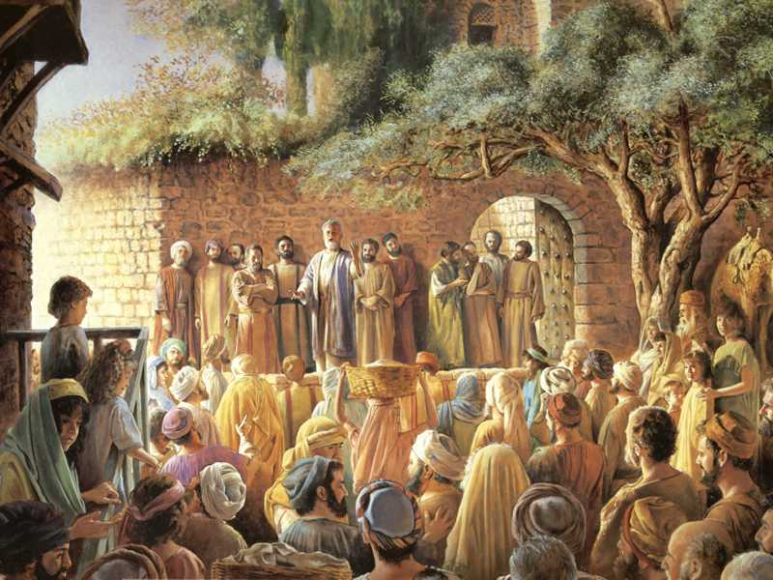
Those who “gladly received” the word, came away…
Changed!
Acts 2:40-42
Notes:
God’s word can change us, yet many who need to change do not. Motivation to change comes when we see our unhappy condition in sin, and humbly turn to God for forgiveness.

Slide 2
The Changed & The Unchanged
People are changed by the power of God’s word.
  Acts 2:40-42; 4:31; 11:26; 17:11-12; Hebrews 4:12
But a hardened heart, calloused by indifference or occupied with this world, can resist God’s word.
  Luke 8:5-15; Ezekiel 33:30-32; James 1:23-24

Slide 3
Motivation for Change
People change when they are unhappy with their condition.
  Mark 2:17
Sinners are ready to change when they are fed up with sin and its consequences in their lives!
  Luke 18:13; 1 John 2:15
Are you weary with the way you are?
  Luke 7:36-50; Matthew 21:31-32

Slide 4
Looking to change?
I looked at the church, and saw all who needed changing who never seemed to change.
And I grew weary from looking and seeing only the same.
I went home just as I came.
I looked at myself and saw all that needed changing that I never seemed to change.
And I became petrified of becoming petrified.
Then I prayed…“Purge me with hyssop, and I shall be clean; Wash me, and I shall be whiter than snow. …Create in me a clean heart, O God, and renew a steadfast spirit within me.” (Psalm 51:7-10)

Slide 5
There is hope for the unchanged!
“I will give you a new heart and put a new spirit within you; I will take the heart of stone out of your flesh and give you a heart of flesh. I will put My Spirit within you and cause you to walk in My statutes, and you will keep My judgments and do them.” (Ezekiel 36:25-27 )
“Repent therefore and be converted, that your sins may be blotted out, so that times of refreshing may come from the presence of the Lord.” (Acts 3:19)

