Slide 1
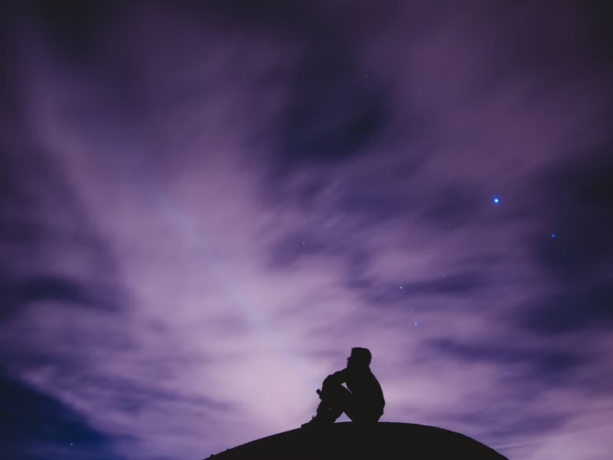
You Are My Hiding Place
Psalm 32
Notes:
As a Christian, your life is hidden, because your sins are covered, your private prayers are heard, God shelters you in times of trouble, and you are guided by the invisible power of God’s word.

Slide 2

God is our Ultimate Hiding Place
“Hide me under the shadow of Your wings” (Ps. 17:8).
“For in the time of trouble He shall hide me in His pavilion; in the secret place of His tabernacle He shall hide me; He shall set me high upon a rock” (Ps. 27:5).
“You shall hide them in the secret place of Your presence From the plots of man; You shall keep them secretly in a pavilion from the strife of tongues” (Ps. 31:20).
“You are my hiding place; You shall preserve me from trouble; You shall surround me with songs of deliverance” (Ps. 32:7).
“He who dwells in the secret place of the Most High shall abide under the shadow of the Almighty” (Ps. 91:1)
“You are my hiding place and my shield; I hope in Your word” (Ps. 119:114).

Slide 3
God Hides my Sins (Psalm 32:1-5)
The man is blessed whose sins are forgiven and hidden by God (32:1-2; Romans 4:7-8; Isaiah 42:25).
The weight of sin can be crushing (32:3-5).
Confession is necessary! (Proverbs 28:13; 1 John 1:9; Psalm 103:12)

Slide 4
My Hiding Place to Pray (Psalm 32:6)
Jesus often prayed in solitude (Matthew 14:23; Luke 6:12; 22:41-42).
He told us to go into a closet to pray (Matthew 6:6; Psalm 42:8).

Slide 5
My Hiding Place in time of Trouble (Psalm 32:7)
Life is filled with all kinds of trouble, but God is our refuge (Psalm 27:4-5; 64:2-4; 61:3-4).

Slide 6
My Hidden Source of Direction (Psalm 32:8-9)
God’s children are willingly guided by communication from Him.
We have been born of the Spirit (John 3:8).
We are led by the Spirit (Romans 8:14).
The Spirit communicates to us through the words of Jesus and His apostles (John 6:63; 1 Corinthians 2:13).

Slide 7
Your life is hidden with Christ in God (Colossians 3:1-3)
Your life is hidden because…
Your sins are covered!
Your private prayers are heard!
God’s invisible presence shelters you in times of trouble!
You are guided by the invisible power of God’s word!

