Slide 1
…
Notes:
Gossip is a subtle and insidious sin which greatly displeases the Lord. In this lesson, we explore the nature of gossip, the origin of gossip, and how it can be avoided.

Slide 2


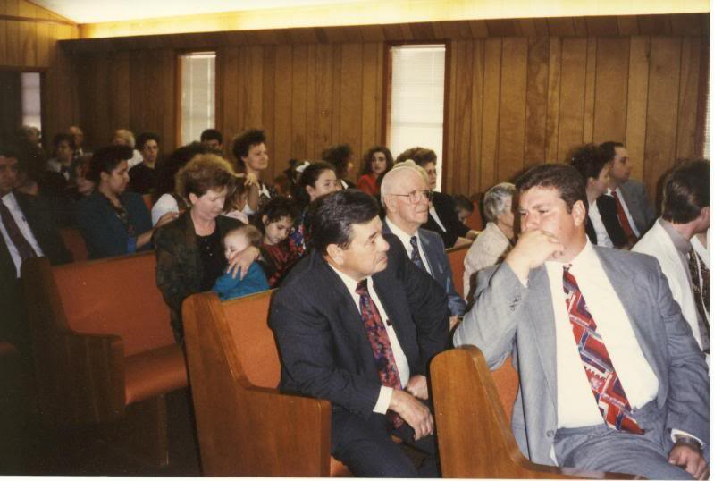

GOSSIP

Slide 3

GOSSIP
Let’s determine to please God with our speech! (Psalm 19:14; Rom. 1:28-30)
Gossip is an insidious sin!

Slide 4
What is Gossip?
Bible synonyms include "tale bearing, whispering, backbiting, and slander."
  Gossip is “casual or unconstrained conversation or reports about other people, typically involving details that are not confirmed as being true.”
  Gossip is unkind, unnecessary and unprofitable (Proverbs 10:18)
  Gossip is often aimed at tearing down and hurting (Lam. 3:62; Psalms 41:6-7; Proverbs 20:19)
  Gossip stirs strife and conflict. (Proverbs 26:20)
  Like many sins, gossip is pleasurable. (Prov.26:22)

Slide 5
The Origin of Gossip
Gossip is a sin of the tongue, ignited by hell! (James 3:6)
It comes from an evil and hateful heart (Luke 6:45)
It is cultivated in idleness (1 Timothy 5:13)

Slide 6
To Avoid Gossiping…
    Evaluate your speech!
When talking to others about others, always ask yourself, “Am I gossiping?”
Before speaking ask yourself, “Is it true, is it kind, is it necessary?” (Ephesians 4:25, 29, 32)
If you can't say something good about someone, say nothing (Romans 12:10).
Keep private matters private (Proverbs 11:13)
Watch out for places & situations where gossip is likely to become a temptation.

Slide 7
Stop Gossipers from Gossiping!
To prevent another from gossiping…
Ask the gossip if he's talked to the person he's talking about (Matthew 18:15)
Get mad about it (Proverbs 25:23)
Refuse to believe that which is not verified (Proverbs 26:24-25 )
Avoid the person who gossips (Proverbs 20:19)

Slide 8
Let’s take the problem of Gossip Seriously
We will give an account!
(Matthew 12:36-37; Psalm 101:5)
Let us fervently pray,
“Set a guard, O LORD, over my mouth; keep watch over
the door of my lips.” (Psalm 141:3)

