Slide 1
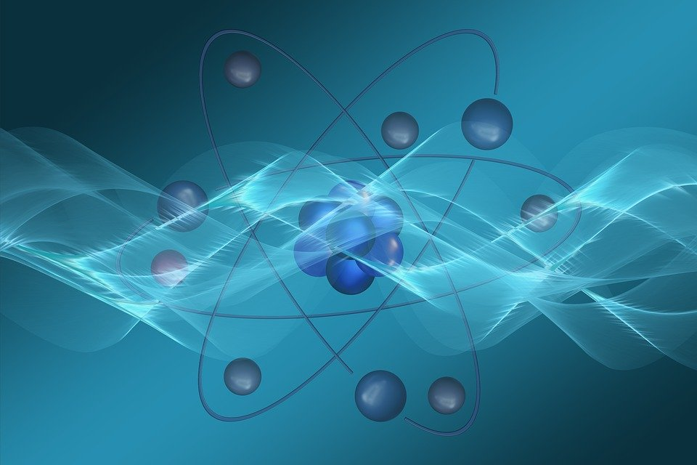
The God of the Little Things that make up everything
Psalm 8:3-4  Colossians 1:16-17  2 Peter 3:10
Notes:
Our God is so big that He is able to use the littlest of things to accomplish His will. He has given us tools to accomplish great things in this world, and He wants to use us as His instruments.

Slide 2
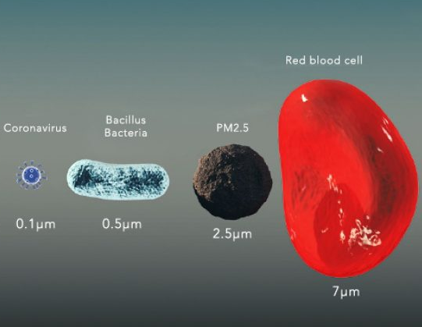
Coronavirus is extremely small, yet it has caused a rather large worldwide pandemic, with all the attending health, political, social, and economic issues.

Slide 3
God Uses Small Tools to do Big Things
A plumb line in the hand of Zerubbabel (Zechariah 4:10; Haggai 2:6-9)
A rod in the hand of Moses (Exodus 4:1-5; 9:23; 10:13; 14:16; 17:5-6, 9-12)
The jawbone of a donkey in the hand of Samson (Judges 15:15-17)
A sling in the hand of David (1 Samuel 17:40-49)

Slide 4
Tools God has Provided Us
His word (1 Peter 1:23-25; Psalm 119:105; 2 Cor. 4:6; Philippians 2:14-16)
Prayer (Ephesians 6:18; 1 John 5:14-15)
Song (Psalm 40:2-5)
“Present yourselves to God as being alive from the dead, and your members as instruments of righteousness to God.” (Romans 6:13)

