Slide 2
Reverence

Slide 3

Disclaimer

Slide 4
Reverence
Webster – A feeling or attitude of deep respect, love, and awe, as for something sacred, veneration, honor or respect felt or shown; profound adoring

Slide 5
Genesis 3:10 And he said, I heard thy voice in the garden, and I was afraid, because I was naked; and I hid myself.

Slide 6
Genesis 17:3 And Abram fell on his face: and God talked with him…

Slide 7
Exodus 3:6 … And Moses hid his face;
for he was afraid to look upon God.

Slide 8
Exodus 34:8 And Moses made haste, and bowed his head toward the earth, and worshiped.

Slide 9
Leviticus 10:3 “I will be sanctified in them that come nigh me, and before all the people I will be glorified.”

Slide 10
I Tim. 3: 14-15- These things write I unto thee, hoping to come unto thee shortly: But if I tarry long, that thou mayest know how thou oughtest to behave thyself in the house of God, which is the church of the living God, the pillar and ground of the truth.

Slide 11
Psalms 89:7 God is greatly to be feared in
the assembly of the saints, and to be had in
reverence of all them that are about him.

Slide 12
Ecclesiastes 12:13 Let us hear the conclusion
of the whole matter: Fear God, and keep his
commandments: for this is the whole duty of man.

Slide 13
“The problem with a casual approach to God is it tends to diminish our fear of God.” Bob Hutto 6/27/10

Slide 14
Arrive On Time

Slide 15
Passing Notes, Talking, Not Paying Attention, Etc.

Slide 16
Moving About The Building, Going In And Out

Slide 17
Proper Dress

Slide 18
Matt. 22: 11 And when the king came in to see
the guests, he saw there a man which had not
on a wedding garment:

Slide 19
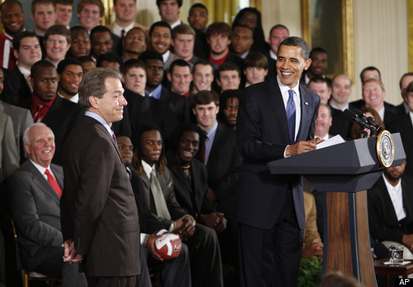

Slide 20
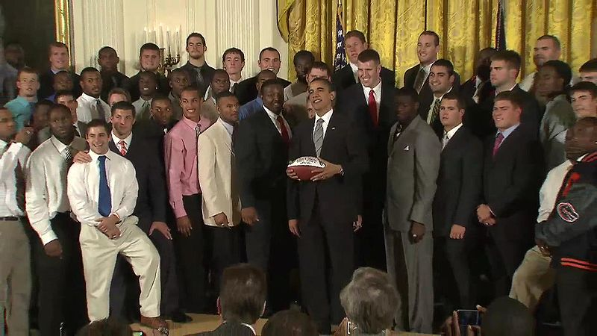

Slide 21
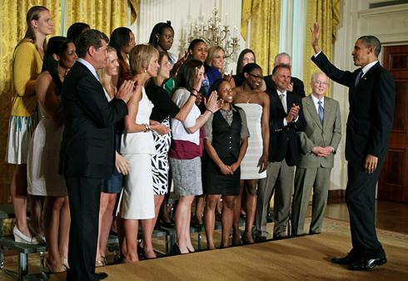

Slide 22
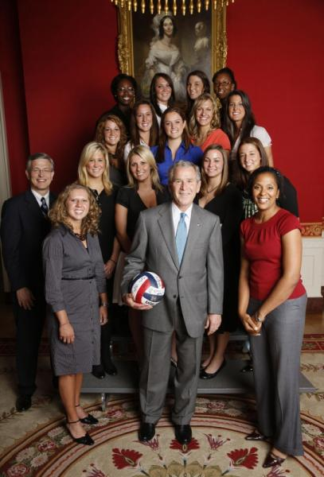

Slide 23
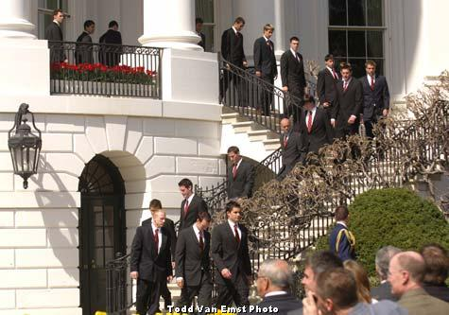

Slide 24
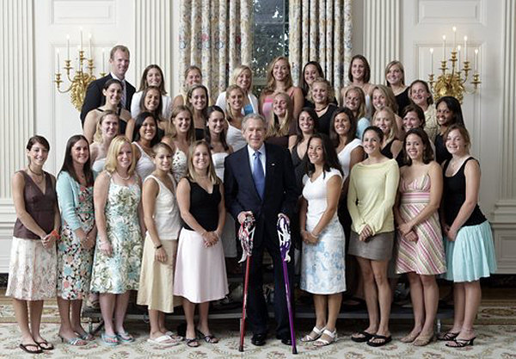
Northwestern women’s Lacrosse Team

Slide 25



Biggest fashion pet peeve: The “casualization” of America Don’t get me wrong -- casual wear is important, and can be fun and stylish. However, on the whole, we’ve stopped caring about what clothing is appropriate for a given situation. Just a couple of examples: flip-flops are never appropriate for work (unless you work in a spa)and pajamas are not appropriate for the supermarket (unless you’ve got the flu and nobody else on the planet is willing to shop for you).

Slide 26
What you wear on the outside is a reflection of who you are on the inside. When people see you, they make judgments about you based on your garments. They might identify you as rich or poor, sophisticated or primitive, exclusive or common. We should dress in such a way that we discerningly show others about our self without leaving any room for negative conclusions.

Slide 27
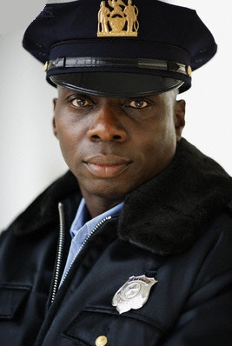


Slide 28

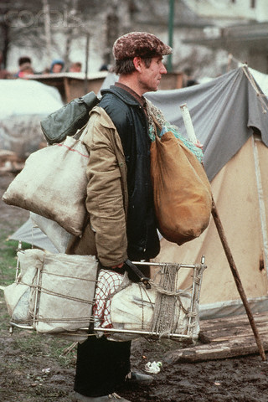

Slide 29
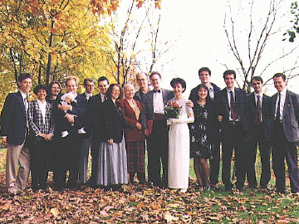

Slide 30
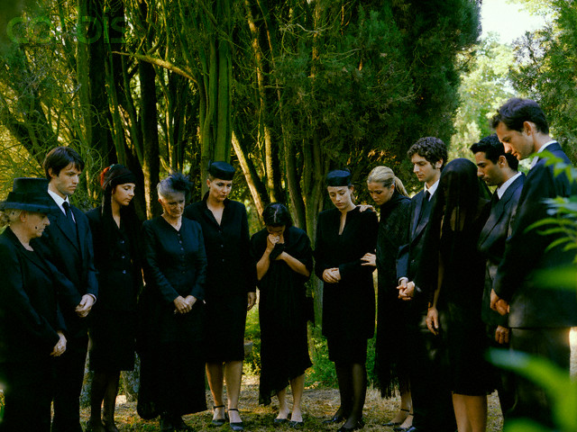

Slide 32
Philippians 4:9 Those things, which ye have
both learned, and received, and heard, and seen
in me, do: and the God of peace shall be with you.

Slide 33
1 Thessalonians 1:3 Remembering without ceasing your work of faith, and labor of love, and patience of hope in our Lord Jesus Christ,
in the sight of God and our Father;

Slide 34
1 Thessalonians 1:3 Remembering without ceasing your work of faith, and labor of love, and patience of hope in our Lord Jesus Christ,
in the sight of God and our Father;

Slide 35
1 Thessalonians 1:3 Remembering without ceasing your work of faith, and labor of love, and patience of hope in our Lord Jesus Christ,
in the sight of God and our Father;
faith that works

Slide 36
1 Thessalonians 1:3 Remembering without ceasing your work of faith, and labor of love, and patience of hope in our Lord Jesus Christ,
in the sight of God and our Father;
faith that works

Slide 37
1 Thessalonians 1:3 Remembering without ceasing your work of faith, and labor of love, and patience of hope in our Lord Jesus Christ,
in the sight of God and our Father;
faith that works
love that labors

Slide 38
1 Thessalonians 1:3 Remembering without ceasing your work of faith, and labor of love, and patience of hope in our Lord Jesus Christ,
in the sight of God and our Father;
faith that works
love that labors

Slide 39
1 Thessalonians 1:3 Remembering without ceasing your work of faith, and labor of love, and patience of hope in our Lord Jesus Christ,
in the sight of God and our Father;
faith that works
love that labors
hope that produces patience

