Slide 1

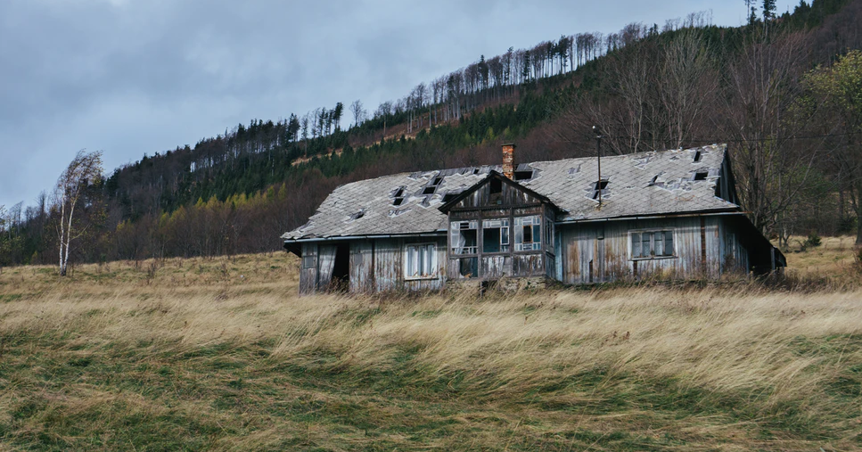
“A house divided against itself will not stand.”
Matthew 12:25
Notes:
Division destroys churches, countries, and cultures. The church at Corinth had a huge problem with it, and yet the epistles that are written to that church offer hope that unity, peace, and steadfastness will prevail. By identifying the causes of divisions, we can heal them and prevent them.

Slide 2
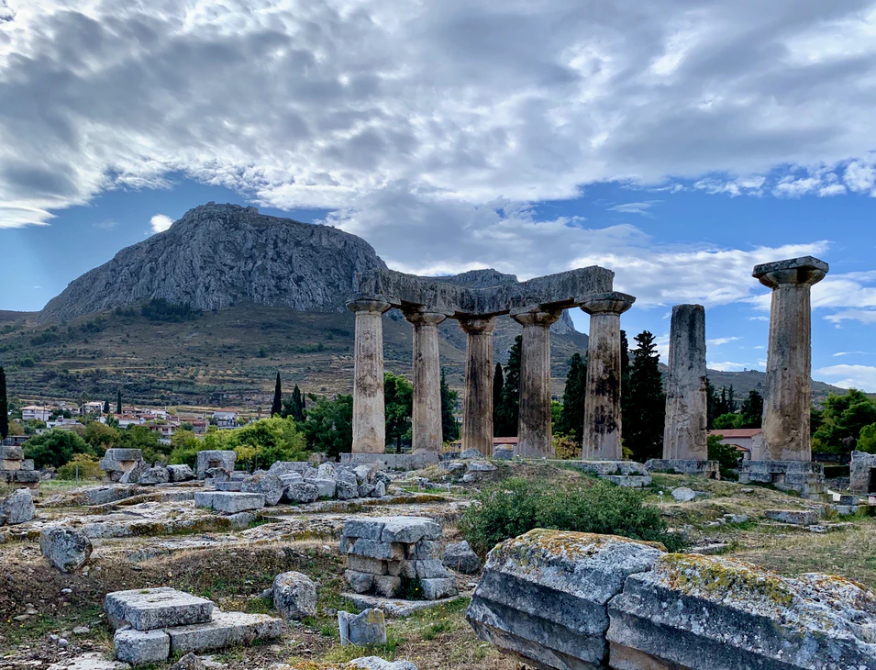
Division WITHIN the Corinthian Church
The church was “torn” by contention. (1 Corinthians 1:10-11)
The congregation was splintered even within the assemblies. (1 Corinthians 11:18)
Should division within have resulted in outward separation? Paul does not recommend it! (1 Corinthians 12:25, cf. Romans 16:1)

Slide 3
In Corinth there were ALL KINDS of Divisions
Personality cults (1 Cor. 1:11-13; 3:3-9; 4:6)
Disputes over things “pertaining to this life” (1 Cor. 6:1, 6-7)
The misuse of personal rights and liberties (1 Cor. 8:1-4, 7-13)
Not partaking of the Lord’s supper in unity (1 Corinthians 11:17-21)
They were warned against murmuring (1 Cor. 10:1-12; Numbers 6:1-3; Jude 11; Acts 6:1; Philippians 2:14)

Slide 4

Was there hope for unity at Corinth?
From what he says in 1 Corinthians 1:10, Paul evidently thought there was hope!
The key to it would be to recognize the causes of division and heed this exhortation: 1 Corinthians 16:14, “Let all that you do be done with love.”
Love would hold things together! Colossians 3:14, “Above all these things put on love, which is the bond of perfection.”

Slide 5
Is there hope for God’s People Today?
YES! But wouldn’t it be an awful thing for Christians to escape harm from the Coronavirus only to be eaten by cannibals in the church?
Galatians 5:13-15, “Through love serve one another. For all the law is fulfilled in one word, even in this: "YOU SHALL LOVE YOUR NEIGHBOR AS YOURSELF." But if you bite and devour one another, beware lest you be consumed by one another!”

