Slide 1
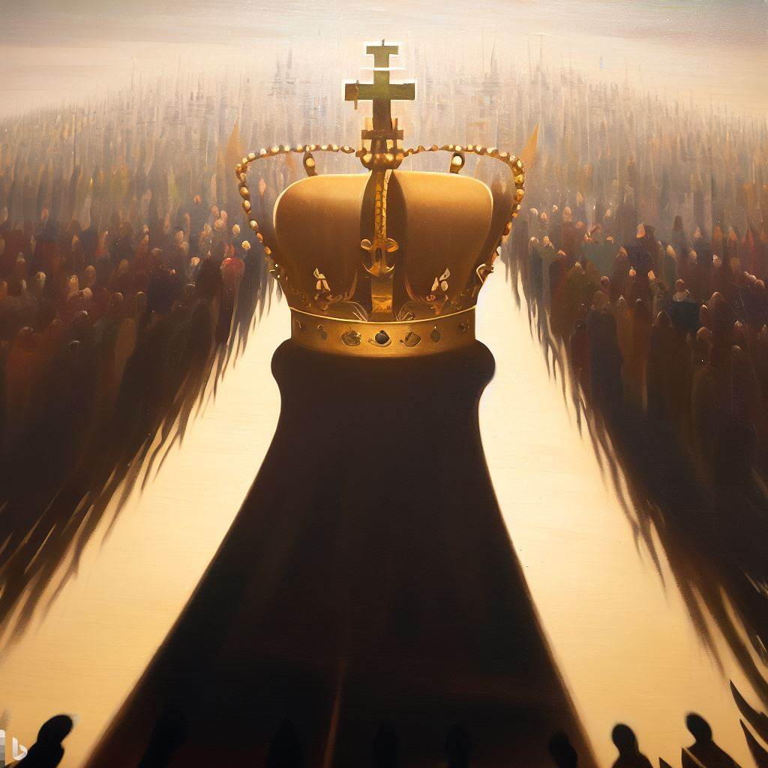
The Kingdom and the Church
Notes:
A kingdom is the dominion of king. A church is an assembly of saints. The kingdom of God and the church that serves Him were both prophesied in the Old Testament. They are different ways of looking at God’s relationship with His people..

Slide 2
The Concept of the Kingdom of God
A Kingdom is the dominion of a king.
In the Old Testament, the Lord has dominion over His creation and rules over the nations (Psalms 22:28; 103:19; 145:11-13; 45:6-7)
But the Old Testament also foretells of the coming of another kingdom (Psalms 45:6-7; 22:27-28).

Slide 3
Prophecies of the Kingdom
God promised an everlasting kingdom with the seed of David as King (2 Samuel 7:12-13; Jeremiah 23:5; Psalm 132:11).
Isaiah and Daniel also speak of the coming King and His kingdom (Isaiah 9:6-7; Daniel 22:44-45).
The New Testament records the fulfillment of these kingdom prophecies (Luke 1:32-33; Colossians 1:13; 1 Thessalonians 2:1; Rev. 1:9).

Slide 4
The kingdom is Spiritual
It does not come with observation; it is within you (Luke 17:20-21).
It is not of this world (John 18:36).
Citizenship is in heaven (Philippians 3:20).

Slide 5
Prophecies of the Church
A “church” is an assembly (cf. Hebrews 12:22-23).
Psalm 89:3-5 foretells that the throne of David will be praised in the assembly of the saints.
Isaiah foretells of the “mountain” of the “Lord’s house” being established (Isaiah 2:3-4).
  A “mountain” often represents a kingdom in Bible prophecy (Jeremiah 51:25; Habakkuk 3:6).
  The “house of God” is the church (1 Timothy 3:15).

Slide 6
Important Conclusions for the Christian
The church and the Kingdom refer to the same realm and relationships but in different ways.
The realm is spiritual.
Those who inhabit the kingdom and the church are saints.
Citizenship in the kingdom is membership in the church.
Submission to the King in the kingdom is submission to the Head in the church.

