Slide 1

“Let Brotherly Love Continue” Hebrews 13:1
Let – allow, encourage
Brotherly – that which is natural to brothers, family
Love – affection
Continue – be maintained without interruption
Notes:
Hebrews 13:1 commands us to “Let brotherly love continue.” Like Jacob & Esau, we can stifle brotherly love through jealousy and self-seeking, deception, bitterness and evil-speaking. Or, we can let love continue by showing kindness and courtesy, honoring each other, covering sins, withholding criticism, serving, and acknowledging our debt of love.

Slide 2
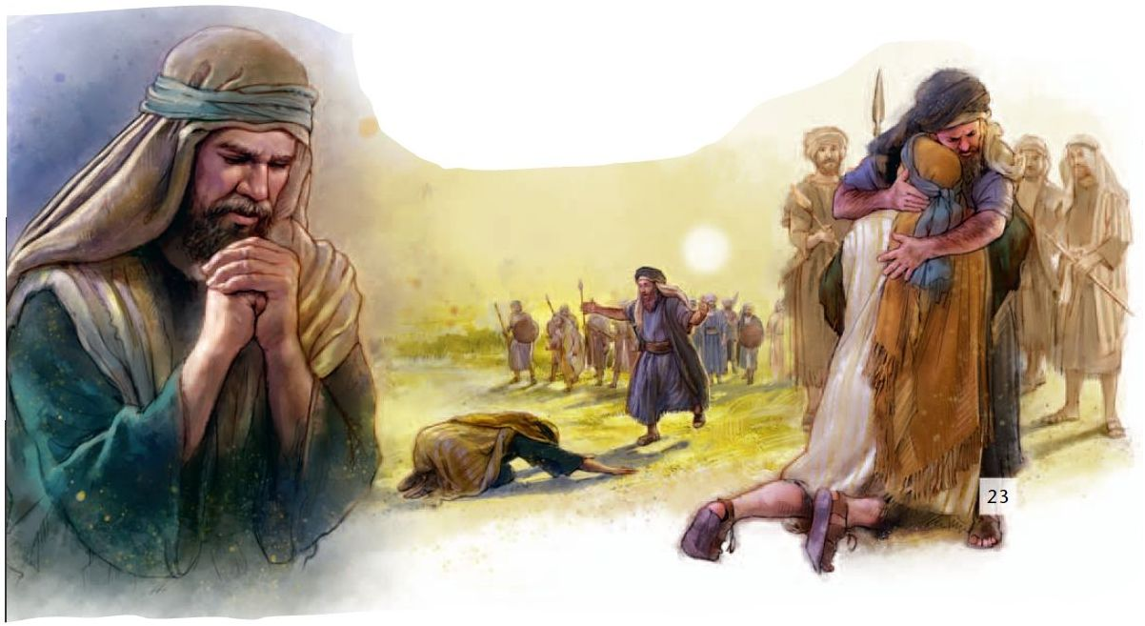
“Let Brotherly Love Continue”
Hebrews 13:1; Genesis 25:26-34

Slide 3
How brotherly love is stifled:
Failure to appreciate ones’ own blessings leads to jealousy, dissatisfaction and self-seeking. (Genesis 25:26-34; 4:8; Eccl. 4:4; 2 Corinthians 10:12; James 3:16; Gal. 5:26)
Deception (Genesis 27:35)
Bitterness (Genesis 27:34; Hebrews 12:15-17)
Criticism and evil speaking (Genesis 27:36)
Hatred (Genesis 27:41; 1 John 4:20)

Slide 4
How to let brotherly love continue
Kindness & courtesy (1 Peter 3:8; Rom. 12:10)
Preference (Romans 12:10; Philippians 2:3-4)
Covering sins (1 Peter 4:8; Colossians 3:12-14 )
Not envying or criticizing (1 Peter 2:1)
Serving your brother (Genesis 32:1-20; 33:4-9; Galatians 5:13; Ephesians 4:1-2)
Acknowledge the debt of love to your brother (Romans 13:8; 1 John 4:11)
Not causing your brother to stumble (1Jn. 2:9)

Slide 5
Pure hearts have sincere and fervent love for brethren
“Since you have purified your souls in obeying the truth through the Spirit in sincere love of the brethren, love one another fervently with a pure heart” -- 1 Peter 1:22

