Slide 1
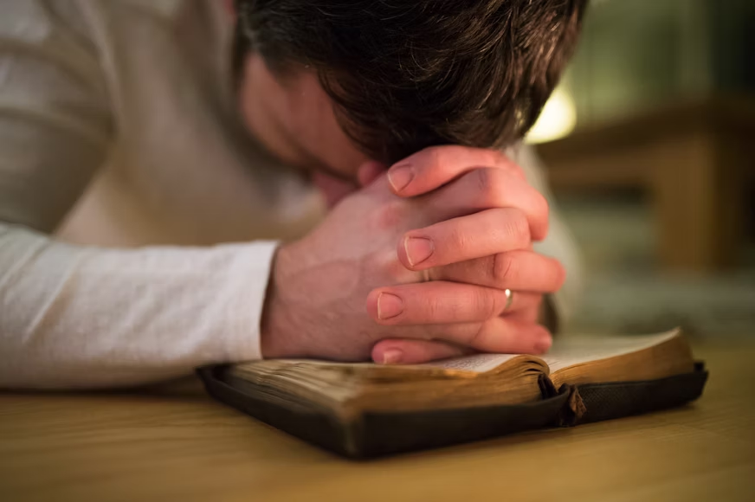
What Suffering does to Faith
Notes:
Many unbelievers point to human suffering as a reason for their lack of faith. But the Bible records numerous instances of faith being established or enhanced through suffering. Suffering can work to make us less inclined to cling to this material world. It can help us learn to rely more on God's word and prayer, and it builds character and increases our faith.

Slide 2
What we learn from Suffering
Suffering keeps this world from becoming too attractive (Heb. 11:13-16; 1 Peter 2:11).
Suffering takes us to God’s word (Psalm 119:50, 67, 71, 92, 143).
Suffering teaches us to pray (Psalm 107:4-19; 18:6; 116:3-4; James 5:13).
Suffering works to purify us and increase our faith (1 Peter 1:6-7; Psalm 66:10; James 1:2-4).

Slide 3
Suffering may Destroy Faith or Strengthen It
Suffering destroys or weakens the faith of some.
But God knows the potential benefits of suffering (Romans 5:3-5; 1 Peter 3:13-15).
God’s intention is to make us like His Son through suffering (Revelation 13:8; Acts 3:18; Hebrews 2:9; 1 Peter 2:21-23; 3:17-18; 4:13).
“Though He slay me, yet will I trust Him…” Job 13:15

