Slide 1
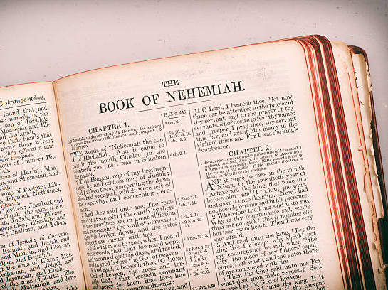
Working with Purpose
Lessons from the Book of Nehemiah
Notes:
People work together with greater unity and diligence when the work they are doing is meaningful. The work God’s people did in Nehemiah’s time had purpose, just as ours does today.

Slide 2
In Nehemiah’s day…
“The people had a mind to work!” (4:6)
  What was their motivation?
“They set their hands to this good work” (2:18)
  What made it “good”?
Nehemiah was doing “a great work” (6:3)
  What made it “great”?

Slide 3
The Purpose of our Work
The people were working to rebuild a reputation
The name of the people of God was at stake (2:17)
God’s people should be known for God’s power working through them (6:16; 2:8, 18; 4:14; 2 Thess. 1:11-12)

Slide 4
The Purpose of our Work
The people were working to rebuild a relationship with God
God used the magnitude and difficulty of the work to drive His people to their knees (1:4, 11; 2:4; 4:7-9)
The people again became God’s covenant people (9:38 & 10:29)

Slide 5
The Purpose of our Work
The people were working to be God’s Holy People
Enabling them to offer acceptable worship to God (12:27, 30, 43)
  We build up the church and shore up its defenses so that we might be a holy people (1 Peter 2:5; Romans 15:16)
This involves separation from the world (9:2; 10:28-29; 13:3; 2:20; 2 Corinthians 6:17)

Slide 6
The Purpose of our Work
Working for the Reward
“Therefore, my beloved brethren, be steadfast, immovable, always abounding in the work of the Lord, knowing that your labor is not in vain in the Lord.” (1 Corinthians 15:58)

Slide 7
The Purpose of our Work
Working for the Reward
"And behold, I am coming quickly, and My reward is with Me, to give to every one according to his work.”
(Revelation 22:12)
Notes:
An appreciation of the purpose of our work for the Lord makes it meaningful. The book of Nehemiah contains important lessons relating to the purpose of our work.

