Slide 1
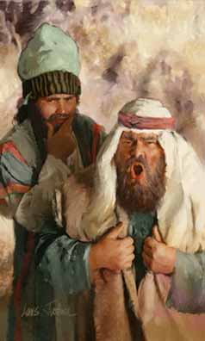
How to be a Pharisee

Slide 2
How to be a Pharisee
Worry much about little things when there are bigger concerns
Worry about specks in the eyes of others when there is a plank in yours (Matt. 7:2-5; 15:1-20; 23:23-24; John 18:28)
Worry about testing the doctrine of others when you haven’t examined your own doctrine. (Matthew 16:1; 19:3; 22:15, 34-36; Luke 11:53-54)
Worry much about the outside when the inside is dirty (Matthew 23:25-26)
Notes:
The Pharisees are great example of what NOT TO BE. They worried about little things but neglected bigger concerns. They knew they were doing wrong but did it anyway. Do not be a Pharisee.

Slide 3
How to be a Pharisee
Know it’s wrong but do it anyway
Seek dispute and strife
  The Pharisees knew or should have known that strife is profitless (Proverbs 17:14, 19; 28:25; 2 Timothy 2:23)
  But they did it anyway (Romans 1:32; Mark 8:11-12; Matthew 12:24-27)
Then weep in self-pity when you lose it all (Matthew 23:33; 38; Luke 13:28)

