Slide 1
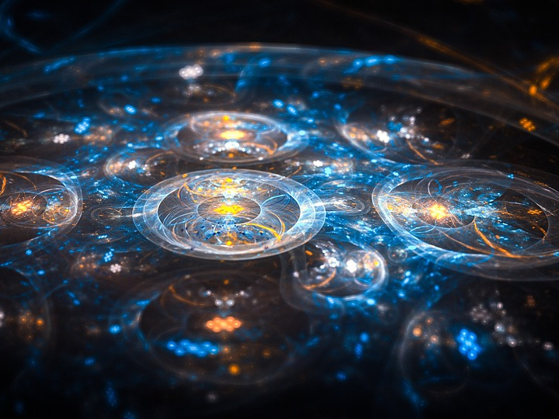
Overcoming the Influences of the World
Notes:
Satan holds sway over the world and uses his terrible power against Christians. To overcome the evil influences of the world, we must love the Father and not the things of the world. Through Christ, we can overcome the world!

Slide 2
Satan has Control of the World
He is like a lion. (1 Peter 5:8)
The whole world lies under His sway! (1 John 5:19)
He is among the “rulers of the darkness of this age.” (Ephesians 6:10-12)
To follow his lead is to be spiritually dead and doomed to the wrath of God! (Ephesians 2:1-3)

Slide 3
Christians do not Walk According to the Course of this World
We are not to love the world (1 John 2:15-16)
Temptation may be endured and it may be escaped, but not if you love the world more than the Father! (James 1:12-15; 1 Corinthians 10:13)

Slide 4
Things We Must Not Love (1 John 2:15-17)
The lust of the flesh (1 Peter 4:3-4; 2 Timothy 4:10)
The lust of the eyes (James 4:1-3; Luke 12:15)
The pride of life (1 Peter 3:3-4; Ecclesiastes 2:18; 1 Thessalonians 4:11-12)

Slide 5
We Can Have Victory Over the World!
We have control of our minds (Romans 8:5; Colossians 3:1-3, 16; Philippians 4:8; 2 Corinthians 10:4-5)
We have control over our bodies (Romans 6:13; 1 John 2:17; 1 Corinthians 6:20)
Jesus Christ is greater than he who is in the world (1 John 4:4; 5:4)

Slide 6
Have you learned the lesson of grace?
“For the grace of God that brings salvation has appeared to all men, teaching us that, denying ungodliness and worldly lusts, we should live soberly, righteously, and godly in the present age” (Titus 2:11-12)

Slide 7
Have you truly been born of God?
“We know that whoever is born of God does not sin; but he who has been born of God keeps himself, and the wicked one does not touch him. We know that we are of God, and the whole world lies under the sway of the wicked one.” (1 John 5:18-19)

