Slide 1

Jesus is the Christ
Biblical, Historical, and Archaeological Evidences
Notes:
An examination of some of the key evidences which prove that Jesus is the Christ the Son of God.

Slide 2
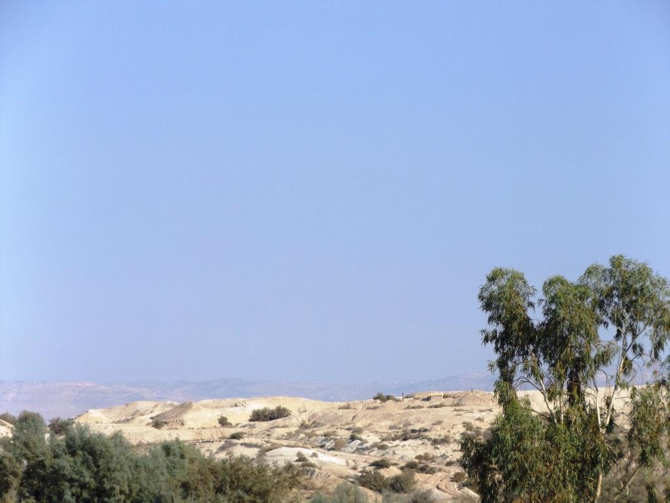
The Testimony of John the Baptist
John the Baptist bears “witness” that Jesus is the Son of God (John 1:29-34; 5:33)
The testimony of John the Baptist is weighty!
The Jewish people “all counted John as a prophet indeed.” (Mark 11:32)
This is confirmed by at least one historical source:
“Now some of the Jews thought that the destruction of Herod's army came from God, and that very justly, as a punishment of what he did against John, that was called the Baptist: for Herod slew him, who was a good man, and commanded the Jews to exercise virtue, both as to righteousness towards one another, and piety towards God, and so to come to baptism…”(Josephus, Antiquities, 18.5.2)

Slide 3
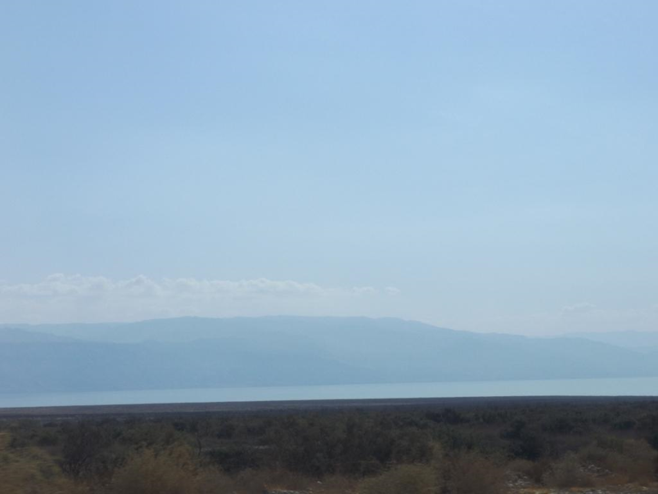
“Do we look for another?” (Matthew 11:2-6; Luke 7:19-23)
When John was in prison, he sent two of his disciples to ask Jesus, "Are You the Coming One, or do we look for another?"
Jesus’ answer was to tell John of the mighty miracles that He was performing.
This evidence was even stronger than John’s testimony (John 5:36).
Jesus may not have been the kind of “Christ” John was expecting!.

Slide 4
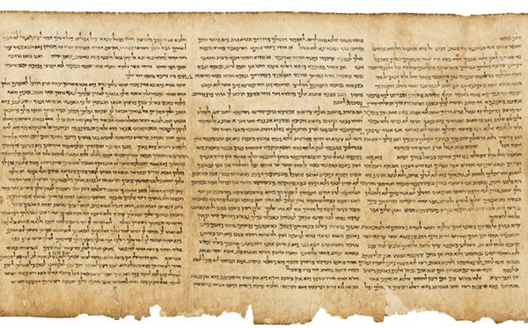

The Fulfillment of Old Testament Prophecy
Christ would be of the lineage of David. (2 Samuel 7:12-13; Psalm 89:20-29; Matt. 1:1; 9:27; 15:22; 21:9)
Born to rule God’s people! (Isaiah 9:6-7)
Born in Bethlehem (Micah 5:2)

Slide 5
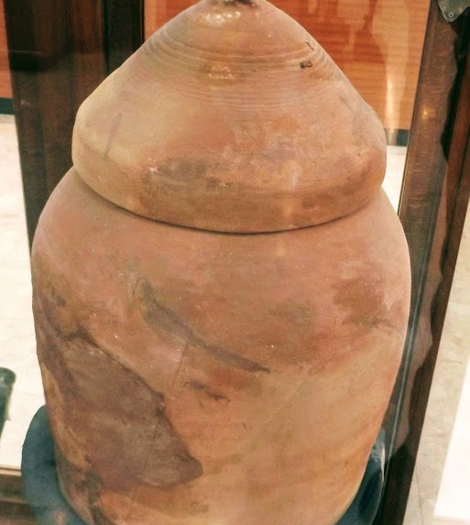
The Fulfillment of OT Prophecies
The Dead Sea Scrolls prove that all of these prophecies were made LONG BEFORE Jesus was born in Bethlehem:
The Isaiah scroll dates to 125 BC.
The Micah scroll dates to the 2nd century BC.
The scroll of 2 Samuel dates to 50 BC.

Slide 6
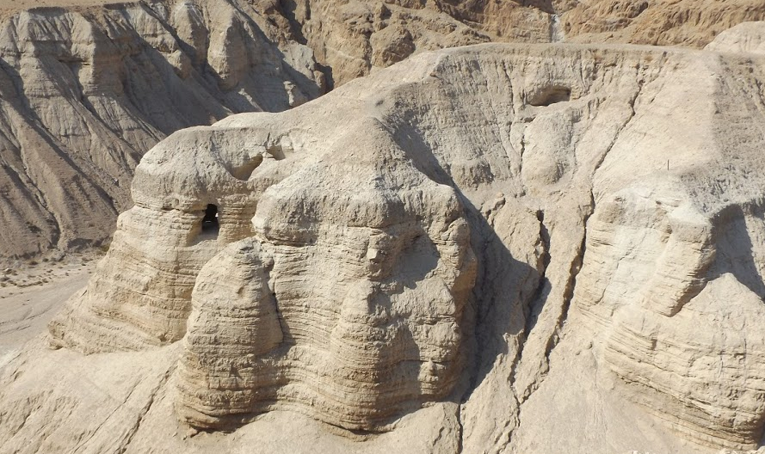

Slide 7
The Evidence from MIRACLES
The miracles of Jesus provide substantial evidence that Jesus is the Christ, the Son of God (John 20:30-31; Acts 2:22)
Jesus pointed to His miracles as evidence (John 5:36; 10:25; 14:11; Luke 5:21-24)
Their value as evidence is bolstered by the following:
They were performed in many places before multitudes.
A wide variety of miracles were performed.
They could not be explained away by Jesus’ enemies (John 11:47)
While we have not seen the miracles ourselves, we have reliable testimony from multiple witnesses that they occurred.

Slide 8

Evidence outside the Bible
References to Jesus’ miracles:
The Jewish Talmud states…
“They hanged Jesus” because “he practiced sorcery.” (Sanhedrin 43a)
“Yeshu practiced sorcery and corrupted and misled Israel.” (Sanhedrin 107b)
Justin Martyr, defended Jesus’ miracles against the claim that He performed His mighty works by “magical arts”
“For they dared to call Him a magician and a deceiver of the people.” (Dialogue with Trypho, c. 160 CE)

Slide 9
Evidence outside the Bible
He is mentioned in Josephus
“Festus was now dead, and Albinus was but upon the road; so he assembled the Sanhedrin of judges, and brought before them the brother of Jesus, who was called Christ, whose name was James, and some others, [or, some of his companions]; and when he had formed an accusation against them as breakers of the law…” (Josephus, Antiquities, 20. 9. 1)

Slide 10
Evidence outside the Bible
He is mentioned by Tacitus:
Tacitus was born in about 55 AD, served in the Senate in the days of Vespasian, and was the Roman governor of Asia; he wrote his annals in 109 AD.
Because Nero was blamed for the burning of Rome “…to get rid of the report, Nero fastened the guilt and inflicted the most exquisite tortures on a class hated for their abominations, called Christians by the populace. Christus, from whom the name had its origin, suffered the extreme penalty during the reign of Tiberius at the hands of one of our procurators, Pontius Pilatus” (Tacitus, Annals, 15.44)

Slide 11
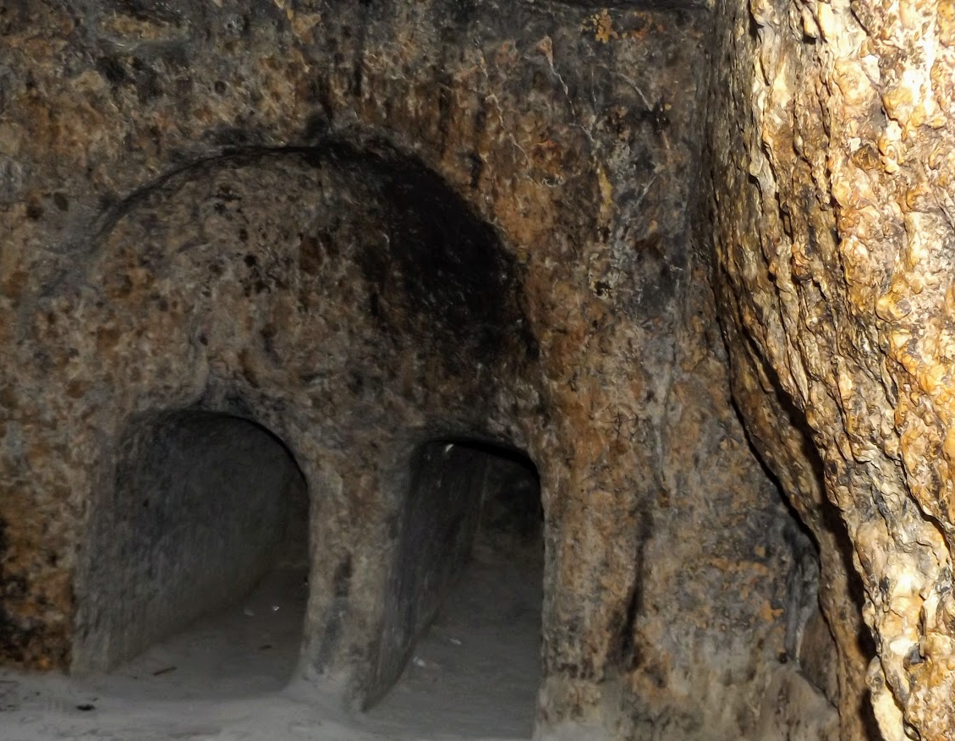
Evidence from Jesus’ Resurrection
He was proclaimed as Christ the King by His resurrection (Acts 2:20-31; 13:32-33; Romans 1:3-4)
There is evidence FOR His resurrection
The tomb was empty
The best explanation is that Jesus arose!
Witnesses saw the resurrected Christ

Slide 12


Two Changed Lives Demonstrate that Jesus is the Christ
Paul (Philippians 3:8-11)
Peter (John 6:66-69; Matthew 16:16; 17:1-5; 2 Peter 1:16-18)

Slide 13
The Father’s Testimony
“This is My beloved Son, in whom I am well pleased. Hear Him!” (Matthew 17:5)

