Slide 1

Keeping the Church Healthy
The Importance of a Sound Church
Notes:
While many churches are concerned about their physical health or fiscal health, a healthy church is one that is fed sound doctrine and protected from infections of sin and doctrinal error.

Slide 2
What does it mean to be “sound”?
“Sound” literally means “healthy” (Psalm 38:3, 7; Isaiah 1:6)
In the NT the word “sound” is usually translated from the Greek word hygiea (hygiene)
When used figuratively, “sound” refers to things that are spiritually healthy (Titus 1:13; 2:1; 2 Timothy 4:3; 1:13)
A church is sound when it is spiritually healthy!

Slide 3

Promoting Soundness By Practicing Good Hygiene
Preachers who teach, preach, and exemplify sound doctrine (Titus 2:1-8)
Shepherds (overseers) who protect the flock from false teachers (Titus 1:9-11; Acts 20:28-31)

Slide 4

What Makes Churches Sick?
Listening to false teaching (2 Tim. 2:16-18; 2 Tim. 4:3-4)
Engaging in or tolerating unhealthy behavior (1 Tim. 1:9-10; 1 Corinthians 11:29-30)

Slide 5
What are the Dangers of Being a Part of an Unsound Church?
You’re probably going to get sick, and you might die!
Doctrinal unsoundness…
Can result in falling from grace (Galatians 1:6-8; 5:2-12)
Can lead to doing many unnecessary and ungodly things (Col. 2:4, 8, 18-23)
Can put us at odds with Christ (Revelation 2:14-16)

Slide 6
What are the Dangers of Being a Part of an Unsound Church?
Personal unsoundness…
Can infect others (1 Corinthians 5:1-7)
Can lead to the death of many (Revelation 2:20-25)
Collective unsoundness…
The entire church could die! (Revelation 2:4-5; 3:1-4)

Slide 7
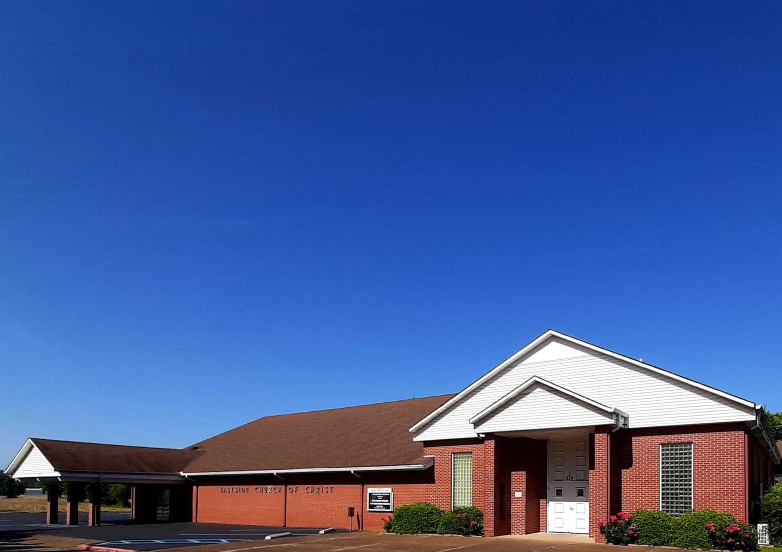
Eastside Church of Christ
Eastside-church.org

