Slide 1
…

Slide 2
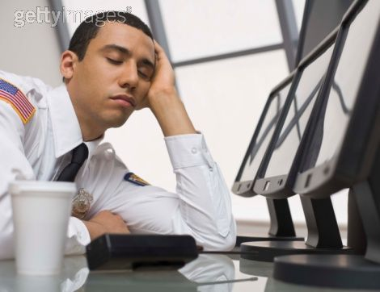

Being of a Sober Mind
Are we asleep when we should be on guard?

Slide 3
Take Heed to Yourself & Watch
Physically Drunk
Lu 21:34-36 "But take heed to yourselves, lest your hearts be weighed down with carousing, drunkenness, and cares of this life, and that Day come on you unexpectedly. For it will come as a snare on all those who dwell on the face of the whole earth. Watch therefore, and pray always that you may be counted worthy to escape all these things that will come to pass, and to stand before the Son of Man."
Mentally Drunk

Slide 4
Definitions
Sophron - safe (sound) in mind, i.e. self-controlled (moderate as to opinion or passion):--discreet, sober, temperate.
Sophroneo - to be of sound mind, i.e. sane, to be in right mind
Nepho - of uncertain affinity: to abstain from wine (keep sober), i.e. (figuratively) be discreet:--be sober, watch.

Slide 5
Be Sober
1Pe 1:13 ¶ Therefore gird up the loins of your mind, be sober, and rest your hope fully upon the grace that is to be brought to you at the revelation of Jesus Christ;
1Pe 5:8 ¶ Be sober, be vigilant; because your adversary the devil walks about like a roaring lion, seeking whom he may devour.
Watch

Slide 6
Hindrances
Physical drunkenness
Cares of the World (Lk 21:34-36)
Passion (Emotionalism) Desires of the Flesh
Remember Sophron: self-controlled (moderate as to opinion or passion):--discreet, temperate.
Do we make our best decisions when we are emotional?
Lev. 10:1; Judges 17:6; Eph. 2:1-3
Pride (Romans 12:3)
Phil. 2:1-4

Slide 7
Sober - Sound Mind
Ability to reason or think clearly (Mrk. 5:1-15)
Commanded of …
Elders (1 Tim. 3:2; Tit. 1:8)
Older Men (Tit. 2:2)
Younger Men (Tit. 2:6)
Older Ladies & Younger Ladies (Tit. 2:3-5)

Slide 8
Sober – Self Controlled
Turn away from the one who has no self control (2 Tim. 3:1-5)
Self Control is a fruit of the Spirit (Gal. 5:22-23)
It is a part of growth in the faith (1 Pet. 1:5-11)
We are to control our bodies (hands, feet & tongue) James 3:1-12
We are to control our mind and emotions

Slide 9
Be Vigilant - Watch
1Pe 5:8 ¶ Be sober, be vigilant; because your adversary the devil walks about like a roaring lion, seeking whom he may devour.
Paul ends 1 Cor. (16:13) with an exhortation to watch

Slide 10
Be Vigilant - Watch
The day of the Lord will come like a thief in the night (1 Thes. 5:2)
People will say, “Peace and Safety” (vs. 3)
1 Thes. 5:6Therefore let us not sleep, as others do, but let us watch and be sober. 7 For those who sleep, sleep at night, and those who get drunk are drunk at night. 8 But let us who are of the day be sober, putting on the breastplate of faith and love, and as a helmet the hope of salvation.

Slide 11
Conclusion
1Pe 1:13 ¶ Therefore gird up the loins of your mind, be sober, and rest your hope fully upon the grace that is to be brought to you at the revelation of Jesus Christ;
Questions:
1) Are we asleep when we should be on guard?
2) Do we need to start resting our hope fully upon Jesus?

