Slide 1


Our Glory and Our Shame
Do we know which is which?
(Isaiah 5:20-24)
Notes:
Satan is working to reverse our perception of the things that are shameful and the things are glorious. We cannot expect to live like Christ so long as we see the world through the eyes of the devil.

Slide 2
Glorifying the Shameful
(Jeremiah 6:13-15; Philippians 3:18-19)
Speaking of wicked things done in secret (Ephesians 5:12)
Nakedness (Revelation 3:18; 16:15; Genesis 3:7-11; 1 Tim. 2:9)
Sin in the church (1 Corinthians 5:1-2; 6:1-5)
Long hair on men, short hair on women (1 Corinthians 11:14-16, 6)
A woman speaking in church (1 Corinthians 14:35)

Slide 3
Ashamed of the Glorious
(Psalm 4:2; 1 Peter 4:14-16)
Tribulations (Romans 5:3-4; 2 Timothy 1:12, 16)
Infirmities (2 Corinthians 12:7-10)
The Gospel (1 Timothy 1:11; 2 Corinthians 4:4; Romans 1:16; 2 Timothy 1:8)
We cannot expect to live like Christ so long as we see the world through the eyes of the devil. (cf. 2 Corinthians 4:3-4)

Slide 4
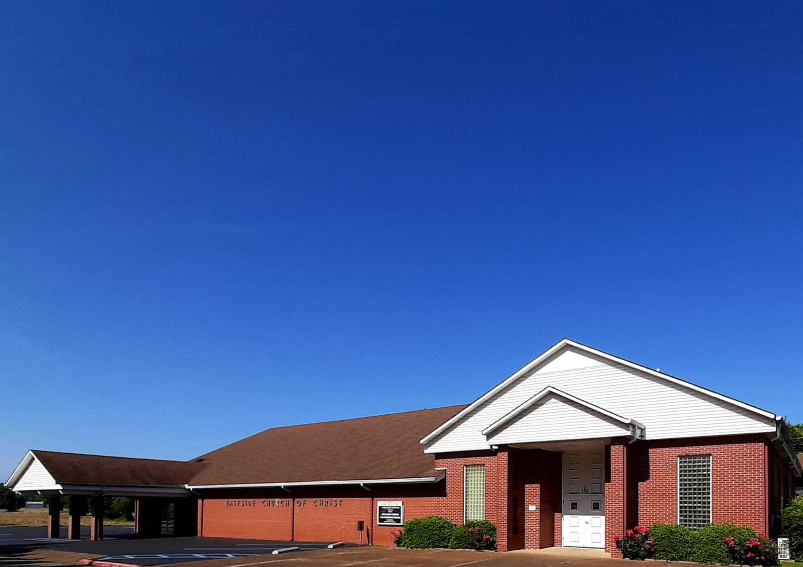
Eastside Church of Christ
Eastside-church.org

