Slide 1
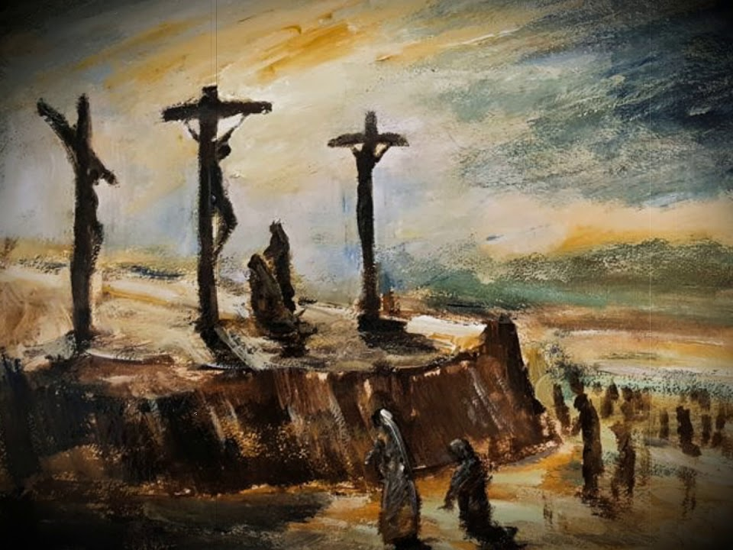
Behold the Lamb!
How Lives are Transformed by the Cross
Galatians 6:14
1 Corinthians 1:18
Notes:
The compelling scene of Jesus dying for us on the cross is the core message of the gospel. It draws us to Him and transforms us from self-centered to self-sacrificial. As we “Behold the Lamb,” our very being is conformed to His and our lives become cruciform – given as a living sacrifice.

Slide 2
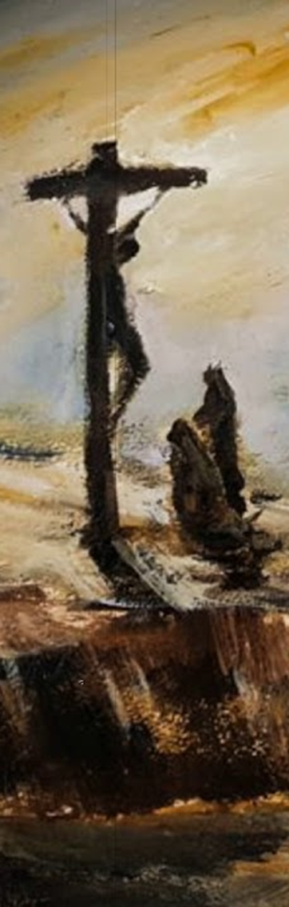
How Lives are Transformed by the Cross
The preaching of the cross of Christ is the core of the gospel (1 Corinthians 1:23-24; 2:2; John 12:32).
The life of a disciple is defined by the Cross (Matthew 16:24; Luke 9:23-24; 14:27).

Slide 3
Looking at the Lamb
Watching the Crucified Lamb (Luke 23:26-49).
He is the center, the crucified forgiver, the expression of God’s love, and the way to His presence (Acts 3:15-19; Romans 5:8; Hebrews 6:19-20).
Disciples lingered at the cross to behold the Lamb (John 1:29; Revelation 13:8; 5:6).
Those who look long and longingly are transformed by the One who hangs there (2 Corinthians 3:18; 5:14-15).

Slide 4
Looking at the Lamb
Consider the impact on those who looked:
Simon of Cyrene (Mark 15:21-22).
The Centurion (Luke 23:46-47; Matthew 27:54).
The acquaintances of Jesus (Luke 23:48-49, 55; Acts 1:14).

Slide 5
Is your life a cruciform life?
The cross ends our worldly existence (Galatians 6:14; 2:20).
Our lives become a living sacrifice (Romans 12:1; Philippians 2:3).
The cruciform life chooses to give itself for others (Romans 15:3; 14:14-15; 1 Corinthians 8:1-12; Galatians 5:24).
“By this we know love, because He laid down His life for us. And we also ought to lay down our lives for the brethren” (1 John 3:16).

Slide 6
Behold the Lamb!
“And I, if I am lifted up from the earth, will draw all peoples to Myself.” (John 12:32)

