Slide 2
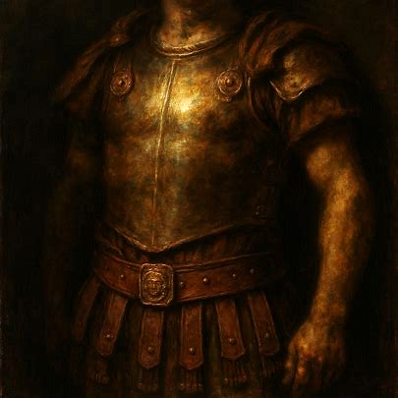
Truth and Righteousness
Ephesians 6:14
Notes:
Truth is the foundation of God's rule and of our spiritual armor, while righteousness is living in and being in alignment with the truth revealed by God's Holy Spirit. The belt of truth and the breastplate of righteousness are vital components of the armor of God that we must use to defend ourselves from the forces of evil.

Slide 3

The Armor of Truth and Righteousness
The Belt of Truth
Truth is at the heart of discipleship (John 8:31-32).
Satan seeks to harm us with lies (John 8:44; 2 Corinthians 11:3; Ephesians 4:14; 1 Timothy 4:1-3).
Christians must speak “truth in love” (Ephesians 4:15).

Slide 4
The Armor of Truth and Righteousness
The Breastplate of Righteousness
Righteousness comes from the power of the “truth of the gospel” working in us as we trust it and Him (Ephesians 1:13).
It is maintained by trust in God’s grace coupled with actively pursuing the right path at every juncture (Philippians 3:9; 1 John 3:7).

Slide 5
The Armor of Truth and Righteousness
Truth & Righteousness Together
Those who dwell with God do right and speak truth (Psalm 15:1-2).
Righteousness and truth are bound together in the word of God and its application (Psalms 33:4; 119:60; 111:7-8; Proverbs 12:17).
We must speak God’s righteousness and keep His truth (Psalm 40:9-10; Isa. 26:1-2).

Slide 6
The Armor of Truth and Righteousness
Truth & Righteousness Together
Truth and righteousness are unused by those whom Satan conquers (Romans 1:18; 2:8; 2 Thess. 2:12).
If you are to stand against the onslaught of evil, you will do so “having girded your waist with truth, having put on the breastplate of righteousness” (Ephesians 6:10-14).

