Slide 1
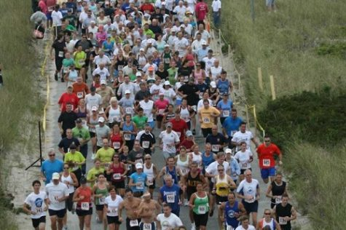
ENDURING for the SAKE of the ELECT
2 Timothy 2:10
Notes:
At our best, we may do something for others that we would not do for ourselves. One strong motivation for Christians to run their race with endurance is an abiding concern for the eternal welfare and salvation of others. The apostle Paul declared, “I endure all things for the sake of the elect, that they also may obtain salvation.”

Slide 2
Who are the elect?
They are called by the gospel and chosen by God to obtain glory (2 Thessalonians 2:13-14; 1 Thessalonians 1:2-4).
They are God’s chosen children, priests, and nation (1 Peter 2:9).
They are faithful and enduring warriors in the long victory of the cause of Christ (Revelation 17:14).

Slide 3
What will we endure for the elect?
Affliction and persecution (2 Cor. 1:6; Eph. 3:13).
Expending ourselves and our resources (Phil. 2:17; 2 Cor. 12:14; Heb. 10:32-34; Acts 4:34-35).
Dealing with one another’s sins and shortcomings (Col. 3:12-14).

Slide 4
Let us endure for the sake of the elect!
“I now rejoice in my sufferings for you and fill up in my flesh what is lacking in the afflictions of Christ, for the sake of His body, which is the church” (Colossians 1:24).

