Slide 1

Learning Obedience
Hebrews 5:8
Notes:
Humans tend to have difficulty learning to obey. Jesus showed us how. He learned obedience by the things that He suffered. Our obedience should emulate His. Obedience means doing your duty, whatever your duty may be, no matter how difficult it may seem.

Slide 2

Problems with the Concept of Obedience
We have a better idea – we know more than the one in authority (2 Kings 5:1-14).
We rationalize disobedience – we don’t do exactly what we’re told, but we think we have good reasons (1 Samuel 15).
We like convenience more than compliance (1 Kings 12:26-29).

Slide 3
Jesus Learned Obedience by Suffering
Jesus was troubled as the cross grew near, but the will of His Father was His chief concern (John 12:27; Matthew 26:39; Philippians 2:6-8).
Jesus learned obedience by experiencing it in its’ purest form (Hebrews 5:7-9).

Slide 4
Obedience in Trial and Adversity
Our obedience is to emulate the obedience of Christ (Philippians 2:12)
We should expect a “fiery trial” (1 Peter 4:12-16).
We overcome the difficulties of obedience through faith and love (1 John 5:2-4)
Obedience means doing your duty, whatever your duty may be (Luke 17:10).

Slide 5
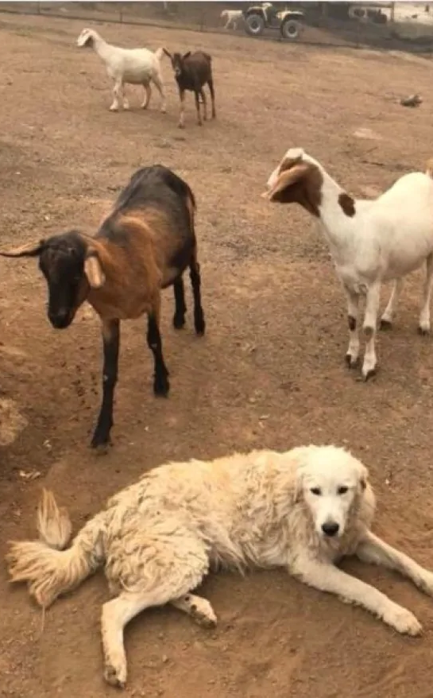
We have Two Primary Duties
Jesus said to him, ‘You shall love the lord your God with all your heart, with all your soul, and with all your mind.’ This is the first and great commandment. And the second is like it: ‘you shall love your neighbor as yourself’ (Matt. 22:37-39).
Are we learning obedience?
Odin –
a Great Pyrenees “Goat Dog,” doing his duty.

