Slide 2
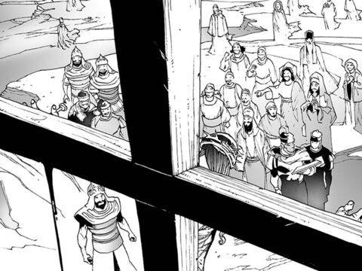
The Sin of Reviling
Luke 6:45
Notes:
The viral sin of reviling will prevent people from inheriting the kingdom of heaven. Instead of being like those who reviled Jesus, let us be like Jesus who did not revile in return!

Slide 3
Men are Tempted to Revile Rulers
It is an age-old problem (Exodus 22:28).
  We need to understand Who is in charge! (Romans 13:1-2)
The Lord will punish those who despise rulers and speak evil of dignitaries (2 Peter 2:9-10, 2:12).
Christians are to be subject to rulers and speak evil of no one (Titus 3:1-2).

Slide 4

Jesus was Reviled but did not Revile!
1 Peter 2:23; Matthew 27:39-44
Let’s not be guilty of reviling others like Jesus was reviled on the cross (1 Peter 2:1; 3:8-9).

Slide 5
Reviling is the Fruit of an Overcritical Spirit
A judgmental spirit damages both the one who has it and those who are victims of it (James 4:11; Matthew 7:1-5).
Judging righteous judgment still requires us to show tender mercies, kindness, humility, and meekness (John 7:24; Colossians 3:12-13).
“Do you not know that the unrighteous will not inherit the kingdom of God? Do not be deceived. Neither fornicators, nor idolaters, nor adulterers, nor homosexuals, nor sodomites, nor thieves, nor covetous, nor drunkards, nor revilers, nor extortioners will inherit the kingdom of God.” (1 Corinthians 6:9-10)

