Slide 1
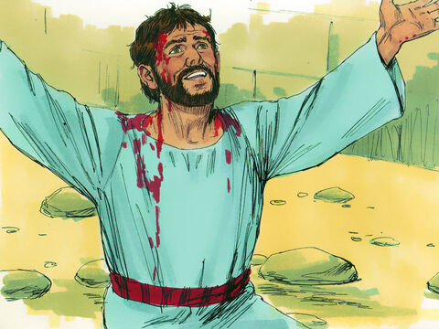
The Prayer of
Stephen
Acts 7:59-60
Notes:
Can Christians triumph over their enemies and persecutors? Can the haters of the cause of Christ be transformed into its supporters? The prayer of Stephen was an instrument of grace used to help accomplish those objectives.
Image courtesy of Sweet Publishing / FreeBibleimages.org.

Slide 2
Stephen’s Sermon
He cites Moses’ prophecy of a coming Prophet (Acts 7:37).
He notes that their fathers did not obey Moses (Acts 7:38-43).
He discusses how the tabernacle was erected according to the Divine pattern, and how David desired a dwelling for God, and Solomon built Him a house (Acts 7:44-47).
He concludes that it is his accusers who have disrespected and disobeyed God, His word, and His prophets. THEY had betrayed and murdered that Christ (Acts 7:51-53).

Slide 3
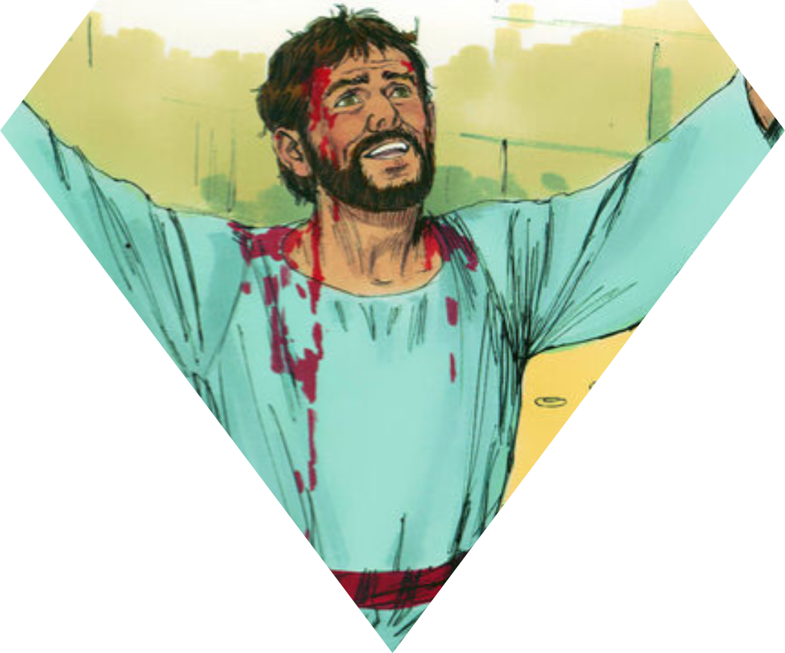
Stephen’s Prayer
Stephen’s prayer was a prayer for the forgiveness of His murderers (Acts 7:59-60; Romans 4:7-8; Luke 23:34)
Stephen’s prayer is a model for dealing with our enemies and persecutors (Matthew 5:43-44; Romans 12:14; 1 Peter 3:9).

Slide 4
Ramifications & Implications of Stephen’s Prayer
It helped accomplish God’s will for Saul of Tarsus (Galatians 1:15; 1 Timothy 1:13-14).
Lamentation and Peace (Acts 8:1-2; 9:31).
We have a tool to transform the world – Prayer! (1 Timothy 2:1-4; 1 John 5:14-15; Psalm 5:2-4).

