Slide 1
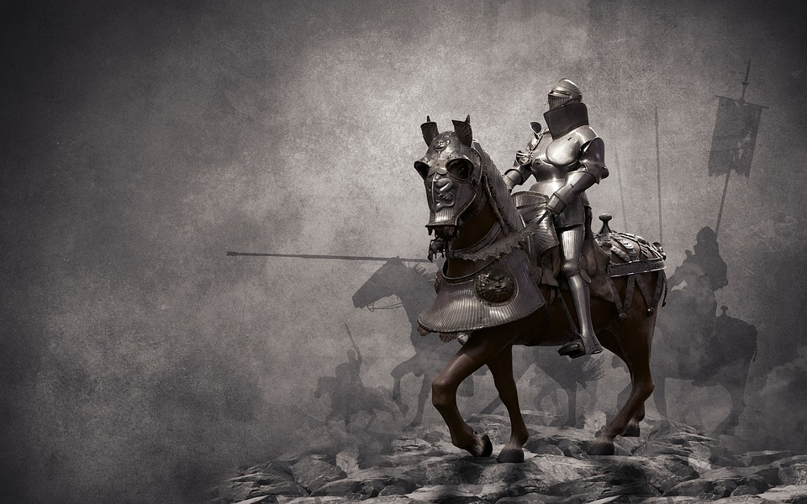
Uniting for The King
Psalm 60:4
Notes:
Christians unite to fight for their Great King in His righteous cause – the cause of truth.

Slide 2

We are Soldiers of a Great King in a Righteous Cause
The King wants us to be dedicated (2 Timothy 2:3-4)
Jesus Christ is the King we serve (1 Timothy 6:12-13; John 18:33-37)
The armies of heaven follow the King! (Revelation 19:11-16)

Slide 3
We Fight to Spread His Truth
We must go "wherever man may dwell" (Mark 16:15-16; Matthew 28:18-20; Colossians 1:28-29)
It is the mission not of one soldier, but of every soldier – the entire army of the Lord working as one! (Philippians 1:27-28)
The victory is ours because of His blood and our devotion to Him and His word. (Revelation 12:11)

Slide 4
Whom do you follow?
For whom are you fighting?
Have you given your life in the cause of Christ? (Mark 8:34-35)
“ ‘But to you who fear My name the Sun of Righteousness shall arise with healing in His wings; and you shall go out and grow fat like stall-fed calves. You shall trample the wicked, for they shall be ashes under the soles of your feet on the day that I do this,’ says the LORD of hosts.” (Malachi 4:2-3)
“And in that day there shall be a Root of Jesse, Who shall stand as a banner to the people; for the Gentiles shall seek Him, and His resting place shall be glorious.” (Isaiah 11:10)

