Slide 1
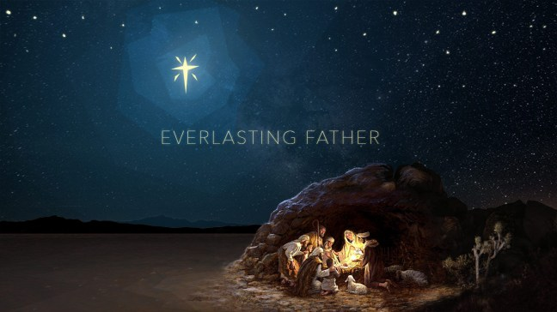
EVERLASTING FATHER
Isaiah 9:6-7
Notes:
Why is the Messiah called “Everlasting Father?” As one of three Divine beings, Jesus occupies the position of the Son of God. Yet, those who have faith in Him are said to be His children; they are those to whom He has given life, and those to whom He has declared His heavenly Father.

Slide 2

God the Father and Christ the Son are Distinct Beings
God is the Father of Jesus Christ (Ephesians 1:3; John 20:17)
The Father sent the Son (John 3:16-17; 6:38-39; 8:29)
The Father is greater than Christ (John 14:28; Luke 1:32; 1 Corinthians 11:3)
The Father and the Son count as two witnesses (John 8:17)

Slide 3
God the Father and Christ the Son are Distinct Beings
The Father and the Son both dwell with those who keep Christ’s word (John 14:23)
Jesus prayed to the Father (John 17:5)
God the Father did not have flesh and bones, but Jesus did (John 4:24; Luke 24:30)
God the Father knew what Jesus did not! (Mark 13:32)

Slide 4
How is Christ our Everlasting Father? (Isaiah 9:6-7)
Jesus addressed those who had faith in Him as His children (Matthew 9:22, 2, Mark 10:24)
He gives life to those saved by His sacrifice! (Isaiah 53:10-11; 8:18; Hebrews 2:13; John 5:19, 21)
Jesus is the explanation of the Father in human terms (Hebrews 1:1-3; John 1:18; 14:9; Colossians 1:15-17)

