Slide 1
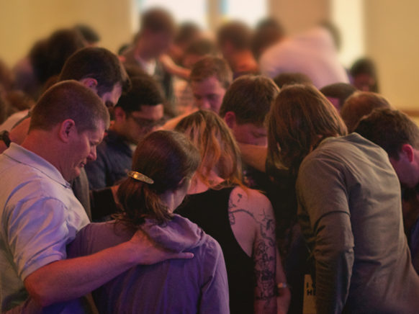
Confession of Sin: an Essential Key to Cleansing and Fellowship
James 5:16
Colossians 3:1-13
1 John 1:5-9
Notes:
Fellowship with God and one another is dependent on walking in the light. Part of walking in the light involves confessing our sins and that we might be cleansed by the blood of Jesus. Confession of sin is essential to fellowship in the light and a vital activity in every church. We must be a community of confessors.

Slide 2

Unconfessed Sin Causes Spiritual Isolation
Psalm 38:3-11 describes the utter misery, pain, and loneliness involved in bearing the burden of sin.
“Sin demands to have a man by himself. It withdraws him from the community. The more isolated a person is, the more destructive will be the power of sin over him…” (Dietrich Bonhoeffer)

Slide 3
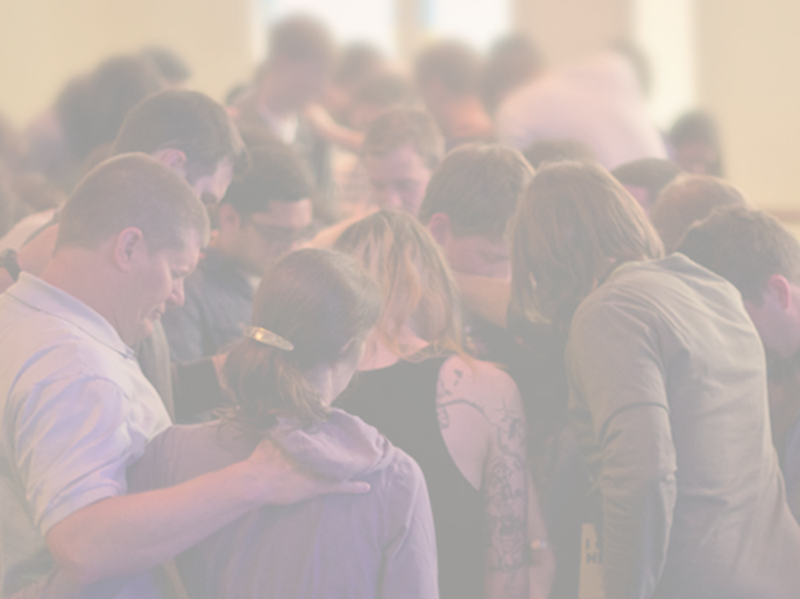
WE NEED A COMMUNITY OF CONFESSORS & Forgivers
According to Colossians 3:1-13, God has provided us with a loving community in Christ for us to confess our sins.
This is part of bearing one another’s burdens (Galatians 6:1-2; James 5:16).

Slide 4
Learning to Give and Receive Forgiveness
Forgiveness must flow from and within the church (2 Corinthians 2:5-11).
Forgiveness must be extended and accepted (Genesis 50:15-21; Luke 17:3-4; Proverbs 28:13).

Slide 5
Confession is a Critical Component of Fellowship
The blood of Jesus cleanses us from all sin if we walk in the light (1 John 1:6-7).
We deceive ourselves if we say we have no sin (1 John 1:8).
“If we confess our sins, He is faithful and just to forgive us our sins and to cleanse us from all unrighteousness” (1 John 1:9).

