Slide 2
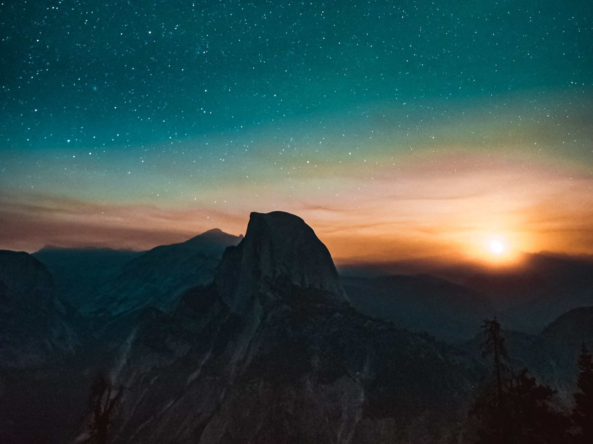
This is My Father’s World
Psalm 24:1-2
Notes:
God is Creator of all things. He is glorified by the mere existence of all His creation, and that is a compelling reason for humans to CHOOSE to glorify Him. His preeminent position as the Almighty Creator makes Him sovereign over the nations of men.

Slide 3

God is the
Creator of All Things
“In the beginning God created the heavens and the earth” (Genesis 1:1).
The creation attests to His existence and power.
  The heavens, the earth, and the seas (Neh. 9:6).
  The inhabitable earth (Isaiah 45:18).
  The unfathomable foundations (Psalms 24:1-2; 104:5).

Slide 4

God is Glorified by All Creation
His glory can be seen by humans everywhere (Psalm 19:1-4; Luke 12:27).
In the sounds of God’s creation, we hear "the music of the spheres“ (Job 38:4, 7, 17; Psalms 135:7; 104:3).
Everything exists to praise Him, but humans get to choose to praise Him (Psalm 148).
  We have great reasons to make that choice! (Romans 1:20; Psalm 139:14; Acts 17:28)

Slide 5

God is in Control of All Things
God rules over the nations (Psalms 22:28; 103:19; 47:7; Daniel 4:32; Amos 4:13; Romans 13:1).
Jesus is the King of kings (Psalm 2; Colossians 1:16-18; 1 Timothy 6:15).

