Slide 1

The One Thing You Lack
Mark 10:17-31
Notes:
The rich young ruler did a lot of things right, but he lacked one thing. The one thing you lack is the often the one thing we won’t do (or not do) in order to follow Jesus.

Slide 2
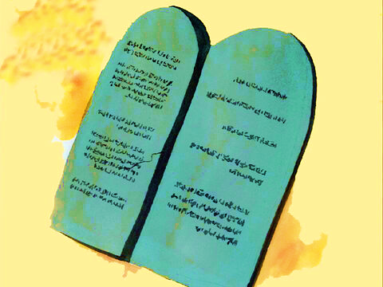
You May be Doing Many Right Things
The rich young ruler did many things right:
He came at the right time – in his youth (Eccl. 12:1).
He came to the right person – Jesus (John 6:67-68).
He came with energy – he was running (Psalm 16:4).
He came with the right attitude – he knelt before Jesus (Philippians 2:10).
He came with the right question: “What shall I do that I may inherit eternal life?”
He had been keeping the commandments (Matthew 19:9; 25:31-46; 1 John 4:20).

Slide 3
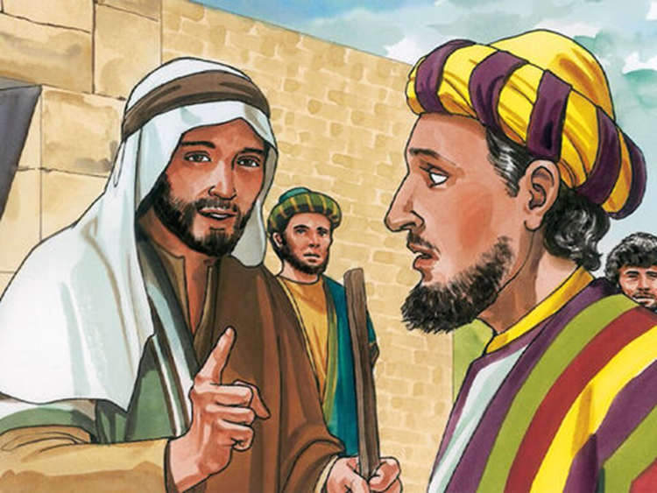
The One Thing You Lack
The rich young ruler lacked ONE THING (Mark 10:21; Luke 9:61-62).
What is the thing YOU are lacking?
  “Then Jesus, looking at him, loved him, and said to him, ‘One thing you lack…” (Mark 10:21).

Slide 4
The One Thing You Lack
The rich young ruler lacked ONE THING (Mark 10:21; Luke 9:61-62).
What is the thing YOU are lacking?
Who can be saved? Can you? (Mark 10:23-25).
  “With men, it is impossible, but not with God, for with God all things are possible” (Mark 10:27).
  “If You, LORD, should mark iniquities, O Lord, who could stand” (Psalm 130:3)?
  “For when we were still without strength, in due time Christ died for the ungodly” (Romans 5:6).

