Slide 1
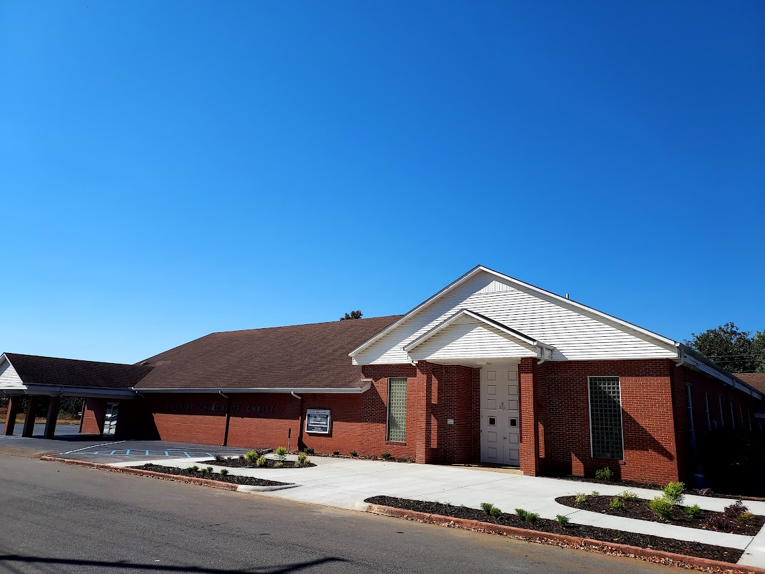
“It is Good for Us to Be Here”
Matthew 17:1-4; 18:20
Notes:
It is good to be where Christians assemble together in the presence of the Lord. It is good to be here, because it is good to worship God, to obey Him, to grow spiritually, to edify the church, to set a good example, to prepare for Jesus’ return, and serve Him with a pure conscience.

Slide 2
“It is Good for Us to Be Here”
It is good to worship God
Worship is pleasant and beautiful (Psalm 147:1).
It brings us closer to God (Psalm 73:28; 1 Corinthians 14:24-25).
It provides an opportunity to thank the One who has done so much for us (Psalm 54:6-7; 92:1).

Slide 3
“It is Good for Us to Be Here”
It is good to obey God
The command not to forsake assembling (Hebrews 10:25).
The command to edify one another (Romans 14:19).
The command to seek first the kingdom of God (Matthew 6:33).

Slide 4
“It is Good for Us to Be Here”
It is good to grow spiritually
Church assemblies are designed to provide spiritual growth (Acts 11:26; Colossians 3:16).
Our growth is dependent upon our diet (1 Peter 2:2).

Slide 5
“It is Good for Us to Be Here”
It is good to help the church function properly.
The church needs workers (Ephesians 4:15-16; 1 Corinthians 12:12-19).
The church is dependent upon its members.

Slide 6
“It is Good for Us to Be Here”
It is good to set a good example
Christians are to set a good example (1 Timothy 4:12).
Faithful church attendance is essential for good influence (1 Peter 2:12).

Slide 7
“It is Good for Us to Be Here”
It is good to be ready for Jesus’ return
Christians are to be prepared (Matthew 25:13; Ephesians 5:16).
Attending every service contributes to our preparation.

Slide 8
“It is Good for Us to Be Here”
It is good to have a clear conscience
A clear conscience is essential to a faithful life (1 Timothy 1:19; Acts 24:16).
Missing services will contribute to a guilty conscience or a seared conscience (1 Timothy 4:2; Hebrews 13:18).

