Slide 1
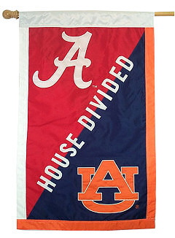
Uniting A House Divided
Differences in favorite teams can cause tension in the home.
Notes:
A house divided cannot stand. We must work for unity in our homes and in the church so that we may serve and glorify God acceptably.

Slide 2
Uniting a House Divided
Differences in favorite faiths can cause eternal tragedy! (1 Kings 11:4; Nehemiah 13:23-24)

Slide 3
Uniting a House Divided
Divided households are inevitable (Luke 12:51-33)
Divided households cannot stand (Mark 3:25)
But divided households CAN be united (1 Corinthians 7:12-16)
And the result of uniting a household is “good and pleasant” (Psalm 133:1)

Slide 4
Uniting a House Divided
Requires effort and determination (Ephesians 4:1-3)
Benefits from male leadership (Joshua 24:15; Hebrews 11:7)
Benefits from a woman’s godly example (1 Peter 3:1-2)
Necessitates that every household member respect God and hear His word (Acts 16:14-15; 18:8; 16:31-34; 10:2-33)
Not only saves souls, but also enables greater service (1 Corinthians 16:15)

Slide 5
Let us Strive for Unity so that We Might Serve & Glorify God as ONE!
“Now may the God of patience and comfort grant you to be like-minded toward one another, according to Christ Jesus, that you may with one mind and one mouth glorify the God and Father of our Lord Jesus Christ.” (Romans 15:5-6)

