Slide 1
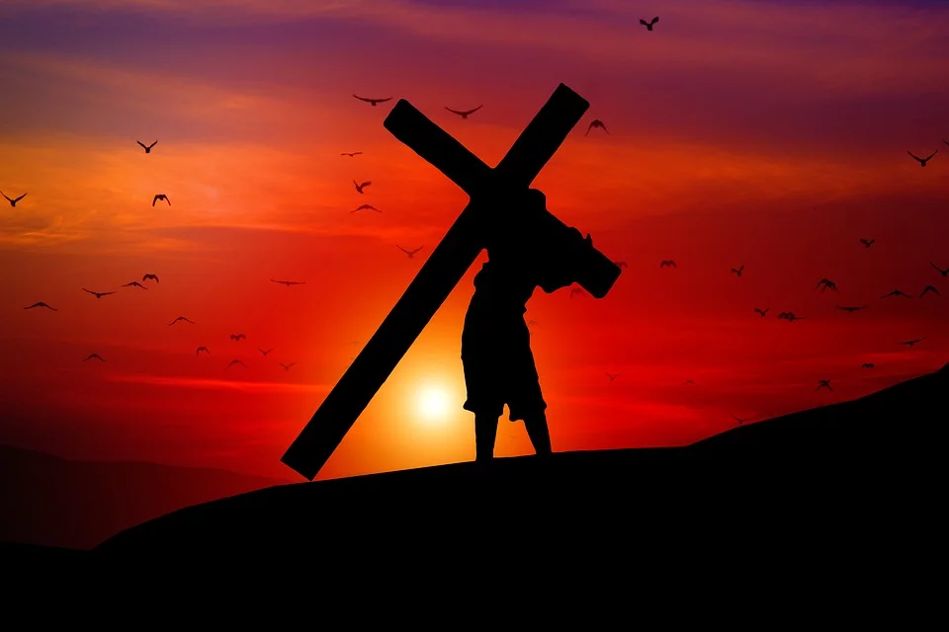
A Chance to Die
“For whoever desires to save his life will lose it, but whoever loses his life for My sake will save it.” - Jesus Christ
Notes:
To follow Christ is to lose one’s life. The old man is put to death, and every temptation and trial thereafter becomes an opportunity to die to ourselves that we might live for Jesus.

Slide 2
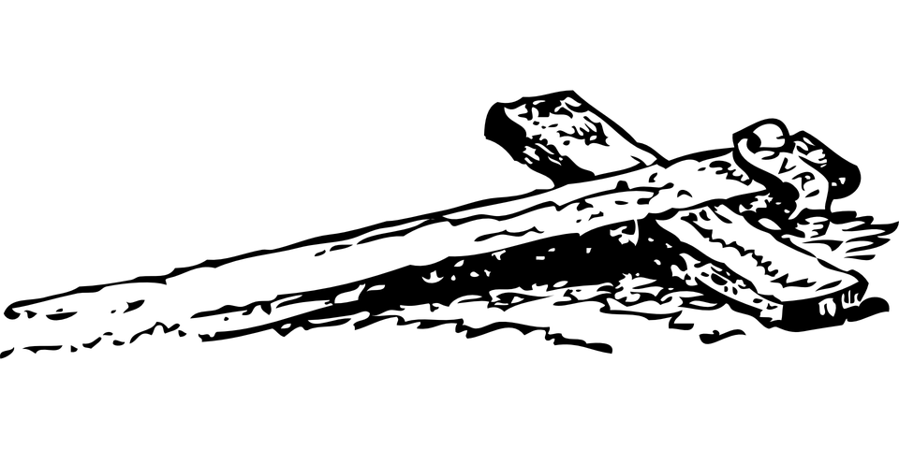
A Chance to Die
Following Jesus means Losing Your Life
This was what Jesus told would-be followers (Luke 9:23-24)
To follow Christ is to partake in His sufferings and ultimately in His death and resurrection (Philippians 3:10-11; Galatians 2:20; Romans 6:4-5)
We have died with Christ so that we should no longer live for ourselves (2 Corinthians 5:14-15)

Slide 3
Seeking A Chance to Die
Every day we carry our cross seeking for a chance to die (1 Corinthians 15:31)
This death is a theme of the epistle to the Colossians (Colossians 2:11-12; 20-22; 3:1-10)
  We must see every temptation and trial as a chance to kill off part of our old man!
“For if you live according to the flesh you will die; but if by the Spirit you put to death the deeds of the body, you will live.”
(Romans 8:13)

