Slide 1
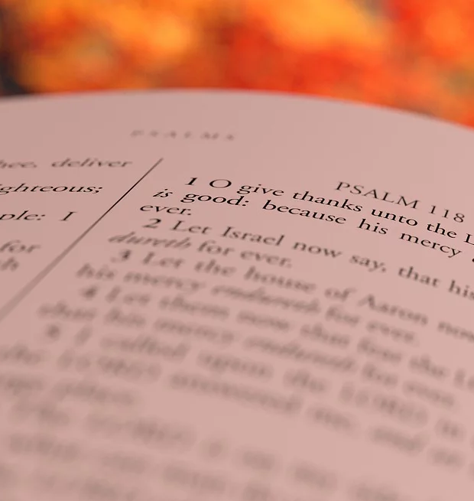
The Unifying Power of Giving Thanks
Notes:
Thankfulness is to be expressed by God’s people always – every day of the year. Being thankful for our brothers and sisters in Christ is a solemn duty, but one that should be expressedfrom the heart. Thankfulness for one another cements unity in the body of Christ.

Slide 2
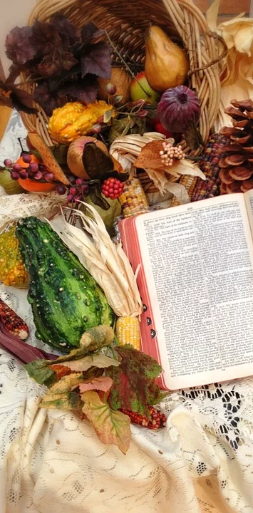
A Scriptural Thanksgiving
Thanksgiving and Prayer must be offered to God daily!
Colossians 4:2
Colossians 3:17
Ephesians 5:20
1 Thessalonians 5:17-18

Slide 3
Giving Thanks for others is a Solemn duty
We are to give thanks for all people (1 Timothy 2:1)
We have a special duty to give thanks for our brothers and sisters in Christ (1 Thess. 1:2; 2 Thess. 1:3; 2:13)

Slide 4
What is Thankworthy about our brethren?
The grace of God in their lives (1 Corinthians 1:4)
Their example of faith (Romans 1:8-9)
Their faith and love (Eph. 1:15-16; Philemon 4-5; Colossians 1:3-4; 2 Thess. 1:3; 1 Thess. 1:2-3)

Slide 5
Loving Thankfulness cements unity
“But above all these things put on love, which is the bond of perfection. And let the peace of God rule in your hearts, to which also you were called in one body; and be thankful.” -- Colossians 3:14-15

