Slide 1

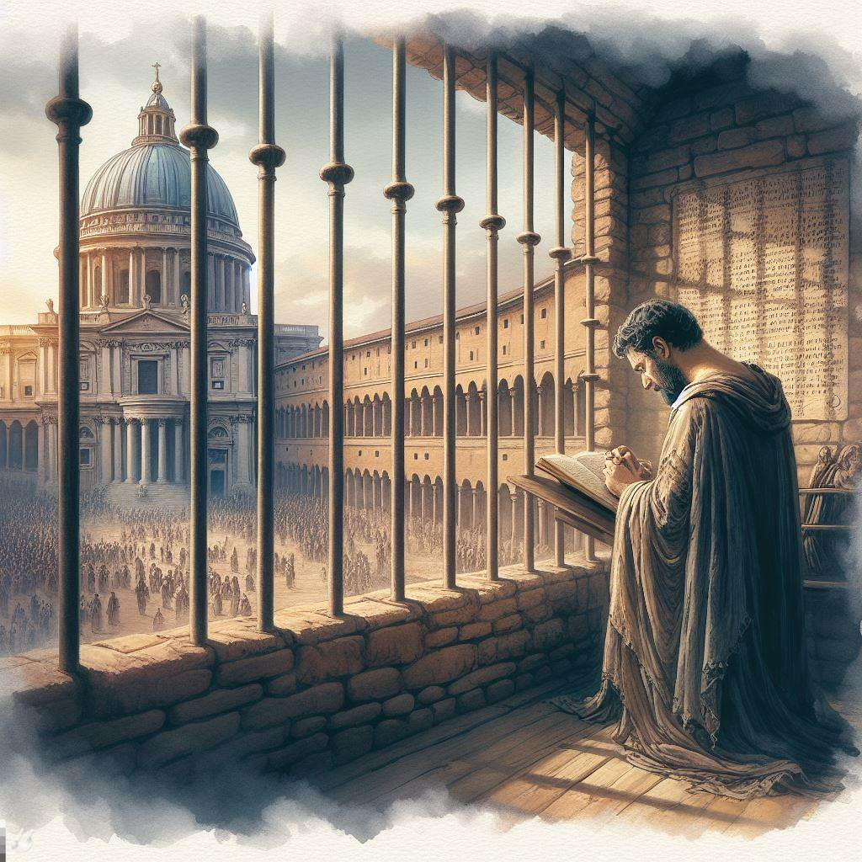
Praying for Deliverance
Matthew 6:13
Psalm 34:17
Notes:
God is our great Deliverer. When we recognize our inability to deliver ourselves from temptations, trials, the bondage of sin, affliction, oppression and death our prayers will be filled with fervent pleas for deliverance.

Slide 2
Praying for Deliverance from Temptations and Trials
We are to pray to be delivered (Matthew 6:13; 1 Peter 4:12).
The “evil day” will come, and we will need God’s help (Ephesians 6:10-18; Psalm 119:170).
God’s deliverance may involve more than we imagine (Genesis 19:12-30; 2 Peter 2:7-9).

Slide 3
Praying for Deliverance from the Bondage of Sin
Simon was bound by iniquity; repentance and prayer were needed for deliverance (Acts 8:21-23).
Pray for deliverance from your transgressions (Psalm 39:7-8; 40:12-13; 51:14; Romans 7:23-24).

Slide 4
Praying for Deliverance from Affliction, Oppression, and Death
God delivers from physical death (Job 33:28-29; Psalm 91:3; 6:2-3).
While the first death is inevitable, the second death is not (Hebrews 9:27; Philippians 1:16-20; 2 Timothy 4:17-18).

Slide 5
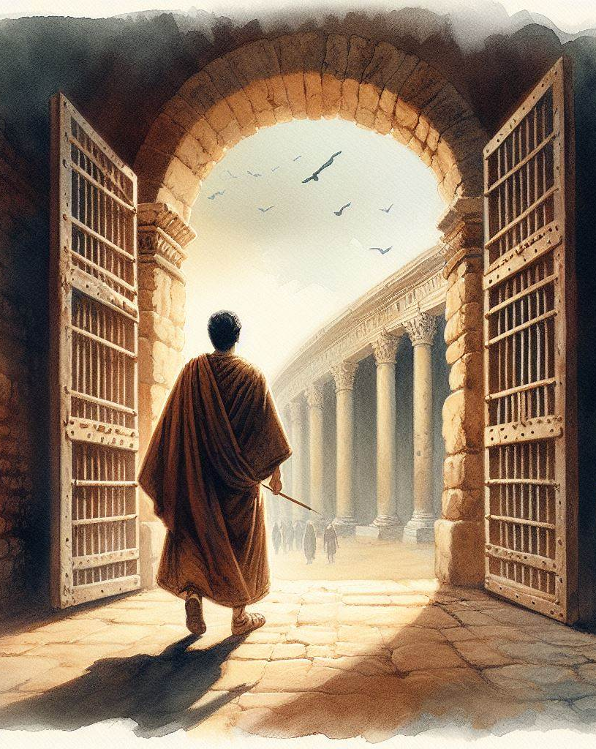
Deliverance at Last
Jesus delivers from the wrath to come (1 Thessalonians 1:9-10; Revelation 20:14).
The Lord is our faithful Deliverer (2 Samuel 22:2; Psalm 42:13, 17).

