Slide 1
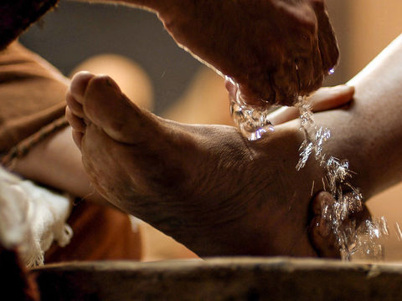
Serving Like the Master
John 13:1-17
Notes:
Our Master was a servant. His love for God and us motivated Him to serve. If we want to be happy, we should be like Him.

Slide 2

Serving like the Master
His Motivation for Service:
Love for others (13:1)
Galatians 5:13; Heb. 6:10
An eternal relationship with God the Father (13:3)
John 16:28

Slide 3
Serving like the Master
The Nature of His Service:
Humble & Menial (13:4-5)
Mark 10:35-45
Insistent (13:6-10)
Acts 16:15; 1 Peter 4:9-10; 5:5

Slide 4
Serving like the Master
A Christian is a Servant!
Every follower of Christ must become a servant (13:14-15)
Jesus left us an example to be followed
Luke 22:25-27

Slide 5
“If you know these things, happy are ye if you do them.” (John 13:17, KJV)

Slide 6
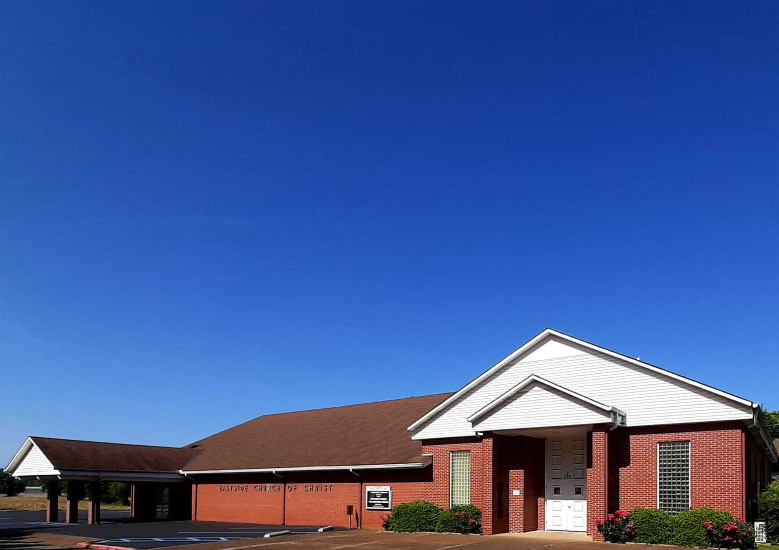
Eastside Church of Christ
Eastside-church.org

