Slide 1
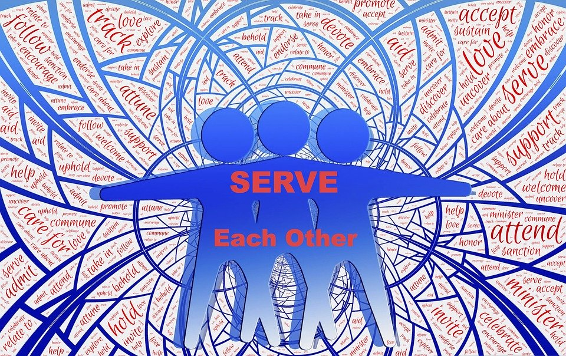

Generational Unity
Keeping the Unity of the Faith from One Generation to the Next
Notes:
How should Christians deal with current generational differences to promote unity in the body of Christ?

Slide 2

What are the primary generations today?
Gen Z, iGen, or Centennials: Born 1996 – TBD
Millennials or Gen Y: Born 1977 – 1995
Generation X: Born 1965 – 1976
Baby Boomers: Born 1946 – 1964
Traditionalists: Born 1945 and before
The three key trends that shape generations are parenting, technology, and economics.
Millennials have become the largest generation in the U.S. workforce.

Slide 3
Each Generation Owes a Debt to Generations Before and After
This is especially true among God’s people. (Psalm 78:1-8)
We receive and pass on God’s truth. (2 Timothy 1:3; 2:2; 2 Peter 1:15)
We owe respect and appreciation to our elders for whatever good they have done. (Proverbs 16:31; Leviticus 19:32)
Generations living in the same time period must serve one another with humility. (1 Peter 5:5; 1 Timothy 4:12)

Slide 4
Generational Changes can Alter the Spirituality of a Culture
It happened in the time of the Judges. (Judges 2:7-11)
Many a generation has done similarly due to selfishness and pride. (Proverbs 30:11-14)
“Every generation must be willing to be different from the culture in order to remain faithful to God.” – Scott Bauer

Slide 5
God’s Mercy and Truth are Needed in Every Generation
God rules over every generation (Lamentations 5:19; Daniel 4:3; Psalm 145:13; 33:11)
God is merciful to His people in every generation (Luke 1:50; Psalm 79:13)
We must make God’s truth known in every generation (Psalms 89:1)

Slide 6
In Every Generation the Unity of the Body Glorifies God
Ephesians 3:20-21 “…to Him be glory in the church by Christ Jesus to all generations, forever and ever.”
Ephesians 4:1-3 “I therefore, the prisoner of the Lord, beseech you to walk worthy of the calling with which you were called, with all lowliness and gentleness, with longsuffering, bearing with one another in love, endeavoring to keep the unity of the Spirit in the bond of peace.”

