Slide 1
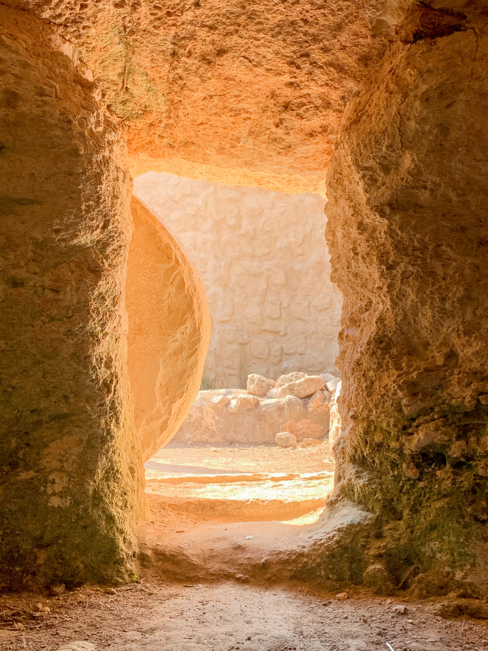
“The Power of His Resurrection”
Philippians 3:8-11
Notes:
The core of the Christian’s faith is the resurrection of Christ. It produces faith and hope, and it empowers us to live our new life in Christ

Slide 2
The Power of His Resurrection
The Power to Produce Faith in Jesus as God’s Son (Romans 1:1-4; Acts 13:30-33; 2:24).
The Power that Gives us Hope of Eternal Life
The empty tomb offers hope of a resurrection (Matthew 28:6; John 20:6-8; Acts 2:29-41)
Because He was raised, we can be raised also (John 11:25; 1 Corinthians 12:15-57; 6:14; 1 Peter 1:3-4; 2 Corinthians 4:14).

Slide 3
The Power of His Resurrection
The Power that Enables our New Life in Christ
We do not have to live in sin (Acts 3:26; Romans 4:24-25).
Baptism is empowered to save us (Romans 6:3-4; 1 Peter 3:20-22; Colossians 2:12).

Slide 4
The Power of His Resurrection
The Power that Enables our New Life in Christ
The Lord’s Supper points us to the coming of Christ!
“By Christ Redeemed” in Christ restored (Titus 2:14; 1 Timothy 2:6; Colossians 1:19-20).
We keep the supper of the Word (John 1:1, 14).
And show the death of our dear Lord (1 Cor. 11:26).
His body given in our stead is seen in this memorial bread (Galatians 3:13; 1 Corinthians 11:23-24).
And as we drink, we see the blood (1 Cor. 11:25).
And thus, that dark betrayal night with the last advent we unite (John 13:30; Hebrews 9:28).
By one bright chain of loving rite UNTIL HE COMES (Exodus 12:24; 1 Corinthians 11:26).

Slide 5
The Power of His Resurrection
The Power that Enables our New Life in Christ
We are raised to live a new life on a higher plane.
To seek things above (Colossians 3:1-2).
To sit in heavenly places (Ephesians 2:4-6).
To experience all things new (2 Corinthians 5:17).

