Slide 1
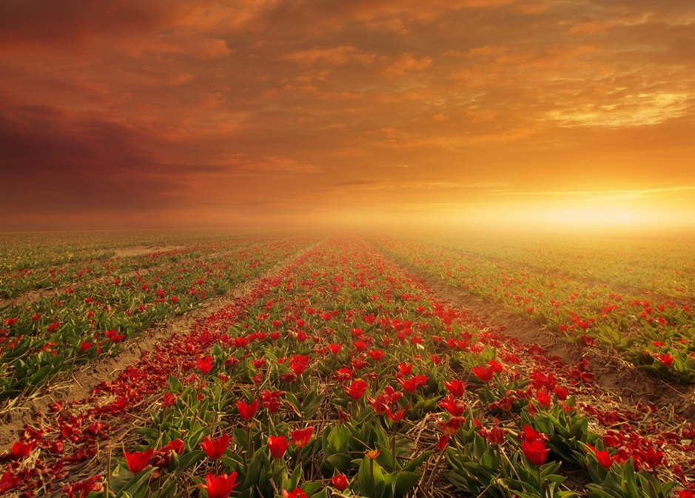
Serving an Eternal God in a Temporary World
“Even from everlasting to everlasting, You are God” (Ps. 90:2)
“As for man, his days are like grass; as a flower of the field” (Ps. 103:15)
Notes:
Man is mortal and lives in a world that is a temporary world. How can he serve a God who is eternal? He must possess eternal qualities that are precious to God, namely, holiness and humility. These qualities demonstrate themselves in a focus on eternal things and a refusal to be attracted to the temporary things, fashions and earthly glories of this life.

Slide 2
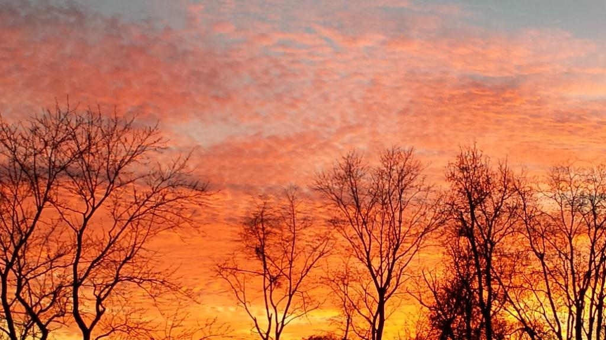
God is eternal.
Our lives on earth are temporary!
We are like fading flowers; God is everlasting! (Psalm 103:14-17)
The name of the Lord declares His eternal existence! (Exodus 3:13-14; Genesis 21:33)
Holiness and humility are necessary for us to transition from this temporary world into His eternal presence (Isaiah 57:15-17)

Slide 3
We must focus on the eternal, NOT ON…
Things
  Psalm 119:36-37; Colossians 3:1-5; Matthew 6:33
Fashion
  1 Timothy 2:9-10; 1 Peter 3:3-4; Isaiah 3:16-26
Earthly Recognition & Glory
  Prov. 25:27; Matthew 6:1; John 5:44; 1 Peter 1:24

Slide 4
If it doesn’t matter in eternity, it doesn’t matter, period!
“Do not love the world or the things in the world. If anyone loves the world, the love of the Father is not in him. For all that is in the world—the desires of the flesh and the desires of the eyes and pride of life—is not from the Father but is from the world. And the world is passing away along with its desires, but whoever does the will of God abides forever.” (1 John 2:15-17, ESV)

