Slide 1
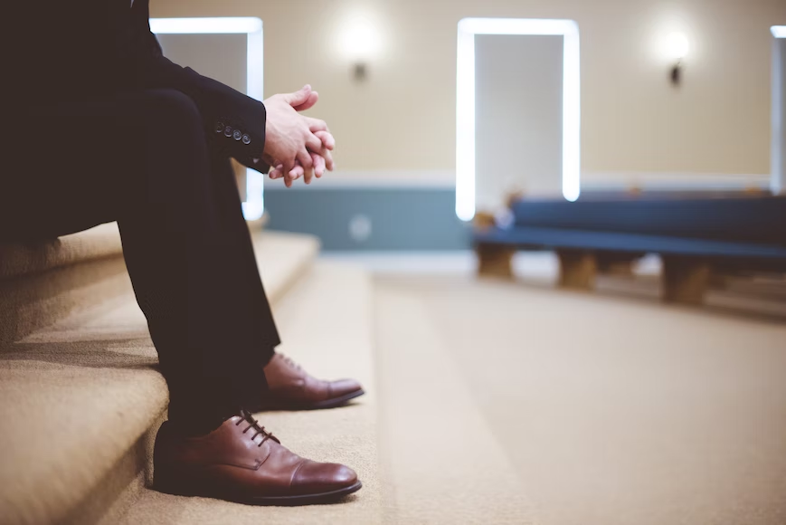
Patiently Enduring in this present Evil World
2 Peter 3:6-8
Philippians 3:18-20
2 Peter 3:13
Notes:
The evil that surrounds us in this world vexes our souls and presses persecution upon us. When human laws enshrine ungodliness, the world becomes even more antagonistic to God and to those who believe in His Word. The godly must patiently endure – relying on God’s promises and waiting for our hope.

Slide 2
Any law that supports evil will promote hatred of what is good.
Such laws and lawmakers have no fellowship with God (Psalm 94:20-21).
Hate will increase…
  Towards God who created humans “male and female” (Gen. 5:1-2).
  Towards God’s Son and His word (Matthew 19:4-5).
  Towards Christians who believe in God, His Son, and His word (Matthew 10:22; 2 Timothy 3:12).
We will either hate evil or hate good (Psalm 97:10; Proverbs 8:13; Amos 5:15).

Slide 3
This present evil world must be endured by the righteous.
We are living in an evil world (Ephesians 6:12).
Endurance is empowered by a hope for something better.
  Abraham trusted God’s promise while waiting for a city (Hebrews 6:15; 11:8-10).
  We also wait for something better (Phil. 3:18-20; James 5:7-8).
  The righteous are to wait to inherit (Psalm 37:1-11; Matthew 5:5).
According to His promise we are waiting for new heavens and a new earth in which righteousness dwells” (2 Pet. 3:13).

