Slide 1

Endurance through Prayer
Romans 12:12
Notes:
Prayer enables endurance. We can observe this in the Scriptures in the lives people of faith and most notably in the life of Jesus Christ. Faith and love, in turn, fuel the prayers that enable endurance.

Slide 2
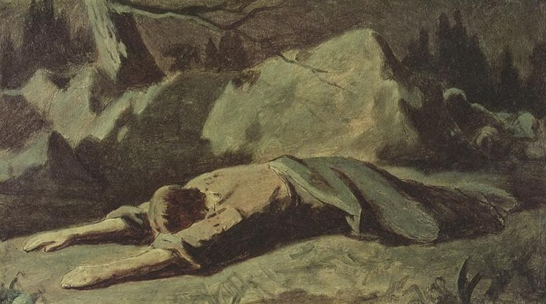
As We Look to Jesus for Endurance
We See Prayer Front and Center
Jesus endured (Hebrews 12:1-2).
Jesus prayed that the cup would pass AND that God’s will would be done (Luke 22:41-44).
His prayer prepared Him to endure the cross (John 18:10-11; Hebrews 5:7-8).

Slide 3
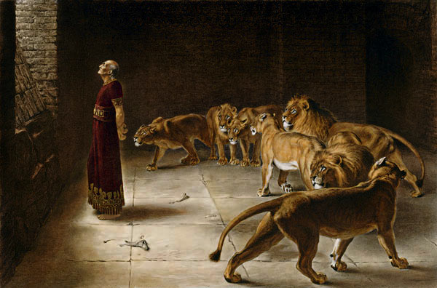
Prayers of Endurance
Jonah faced the consequences of his terrible choices with prayer (Jonah 2:1).
Daniel endured through persecution with persistent prayer (Daniel 6:10 ).
Nehemiah endured the struggles of his people through prayer (Neh. 1:3-11; 2:4; 4:7-9).

Slide 4
Faith and love empower
Prayers of Endurance
Faith and love enabled the Thessalonians to endure (2 Thess. 1:3-4; 1 Thess. 5:17).
When we pray with faith and love, our prayers for endurance are empowered (Jude 20-21; Mark 11:24).
Perseverance in prayer empowers endurance (Ephesians 6:18).
Faith in God’s power and presence will have us calling on Him (Psalms 3:1-6; 16:7-8; 73:23-26; 138:3).

